Slide 1
SCM Process Implementation in SAP FIORI

Slide 2
Introduction to SCM process for JC users.
SAP Firor SCM Processes are used in JCs for the following
Procurement of Material from SDCs
Inventory management for SIM, CAF, MiFi devices, mobile phones, accessories, Marketing collaterals, JIO-POS device, Switch n walk device, FTTx, O&M stocks etc.
Forward and reverse logistics for material movement for 447, P91, retail servers
Timely dispatch to purchase orders from channel partners – ARD, mARD, RD, DxMini stores
Tracking of material movement from one location to other ; Damaged and short stock reporting
Material issuance to service engineers and Direct sales executives
Expense management at JC
Vehicle registration and trip scheduling and execution for material dispatch
Process made simplified in Fiori vis-à-vis direct access to SAP systems to perform daily transactions
Reports and dashboards for transactions executed at JC
Stock reconciliation
Resource management at JC – transfer from one site to other (SCM app user)

Slide 3
Functionalities available in Production(1/7)
# | JC SCM Operations | Number of Applications
1 | Procurement | 1
2 | Inbound Movements | 1
3 | Within JC Process | 13
4 | Physical Inventory Verification | 2
5 | Internal Movements | 2
6 | Outbound Movements | 10
7 | Returns | 1
8 | Report and Display | 6
9 | Additional Processes | 3
10 | Server Agnostics Transportation Processes | 3
Total |  | 42

Slide 4
Functionalities available in Production (2/7)
Procurement
# | Application Name | Description | Role
1 | Purchase Order Display | To View the purchase order details at JC end. Enter Purchase order number or date range to list down the Pos | SCM Executive
Inbound Movements
# | Application Name | Description | Role
1 | Material Receipt | To perform material reciept (GRN) at JC. Allows scanning of pallet, MSN and indiviual serial number capturing of good , damage and shortage quantity | SCM Executive

Slide 5
Functionalities available in Production (3/7)
Within JC Process
# | Application Name | Description | Role
1 | Create/change Reservation | To reserve the stocks against particular orders placed by channel partners | FC&A Executive Role(YEXP)
2 | Device care Receipt / Issue | To receive and issue spares against the requests from DRS | SCM Executive
3 | De-boxing application | To split the article from packed to individual quantity | SCM Executive
4 | SIM Dekitting | To split the packed SIM into single SIM for issuing against purchace orders to channel partners. | SCM Executive
5 | Issue Materials Consumables | To issue consumable materials to respective departments within JC | SCM Executive
6 | Issue Materials Non Consumables | To issue stock materials to channel partners against the purchase orders | SCM Executive
7 | Issue Material Against Reservation for 447 | To issue reserved stock against respetive reservations to channel partners or within JC movements | SCM Executive
8 | MBST - Material Document Reversal | To cancel the material receipt against GRN or to cancel the material issue to channel partner | SCM Executive
9 | Move Stock Return / Damage Area | To move the stocks from one storage location to other vis. Saleable to damage or saleable to stock return | SCM Executive
10 | Reverse goods issue | To reverse the goods issued to channel or within JC. With this, the stocks will be shown at JC storage locations | SCM Executive
11 | Service Enginner Inventory Management | To issue consumable and spares to service engineer mapped to the JC | SCM Executive
12 | Label Printing O&M | To print labels for return dispatches from JC to DC. Label consits of Return doc no, date, Material desc , barcode , etc information | SCM Executive
13 | Swap Stock (inventory movement from JIO Retail to Retail) | To perform material movement from Jio retial to Retail. This is for internal swapping of material within JC locations | SCM Executive

Slide 6
Functionalities available in Production (4/7)
Physical Inventory Verification
# | Application Name | Description | Role
1 | Physical Inventory Proposal | To perform physical inventory reconciliation vis-vis system stock | SCM Executive
2 | Physical Inventory Count | To perform count of Physical Stock | SCM Executive
Internal Movements
# | Application Name | Description | Role
1 | Site to Site Transfer | To transfer stocks from one location to other | SCM Executive
2 | STO create | To create stock transfer order from JC to DC | SCM Executive

Slide 7
Functionalities available in Production (5/7)
Outbound Movements
# | Application Name | Description | Role
1 | Issue Material to Channel | To issue stocks against channel partner orders or internal stock transfer orders | SCM Executive
2 | Create Customer Invoice | To create a billing document against stock issuance to channel partner | SCM Executive
3 | Customer Invoice Cancel, Display | To view the invoice created against channel partner sale | SCM Executive
4 | Create delivery | To create outbound delivery against chanel partner purchase order. Allows to create Delivery against sales order and STO | SCM Executive
5 | Change Delivey : Cancel, Display | To create outbound delivery against chanel partner purchase order. Allows to create Delivery against sales order and STO | SCM Executive
6 | Advance Replacement O&M | Replacement of device spares in advance with O&M partner | SCM Executive
7 | MRO Receipt | To accept the FTTx returns from customer through DRS for inspection | SCM Executive
8 | MRO Issue | To issue the FTTx materials to DRS post inspection | SCM Executive
9 | Sales Order Display | To display the detils of the orders created at JC for channel partner / within locations | SCM Executive
10 | Display/ Print Customer Invoice | To display and print the invoice genearted against sale to channel partner | SCM Executive

Slide 8
Functionalities available in Production (6/7)
Returns
# | Application Name | Description | Role
1 | Return to DC | To create stock transfer order, delivery and billing from JC to DC. Allows ceation of order for Returning products to DC Allows to scan Products to Return Has functionality to auto post Delivery, Good issue and Invoice creation | SCM Executive
Report and Display
# | Application Name | Description | Role
1 | Stock overview | To view the stock details within JC. Allows user to get view of all stocks lying at different storage locations. Display Qty and Bin Number details of an Article in respective Slocs | SCM Executive
2 | Article Master Display | To display the article master list within JC with detials of the product | SCM Executive
3 | Daily transaction Register | To generate daily transaction register at JC level. Daily reciepts, issued and transfers | SCM Executive
4 | Pending GRN Report | To list down the list of documents pending for GRN at JC | SCM Executive
5 | Print Material Document | Allows to print the Movement relevant documents at JC | SCM Executive
6 | Display Stock Transport Order | To display details of stock transfer order created by JC | SCM Executive

Slide 9
Functionalities available in Production (7/7)
Additional Processes
# | Application Name | Description | Role
1 | Application for changing site user | Allows JC Manager to change site for JC Executives | Admin
2 | Non Valuated Inventory Upload | To upload the initial stock of non valuated articles | SCM Executive
3 | Service Entry Sheet | To create a service order for required services within JC | SCM Executive
Server Agnostic Transportation Process
# | Application Name | Description | Role
1 | Vehcile / courier / biker register (IN/OUT) | Allow to capture details of a vehical coming inside JC at site. Allow to capture details of a vehical Goinig Outside at JC site | SCM Executive/SLP
2 | Transportation Scheduling | Allow Grouping of Multiple deliveries belongs to different SHIP-TO party | SLP
3 | Transportation Execution | Allows loading of Deliveries grouped during Scheduling | SLP

Slide 10
Procurements
Purchase Order Display

Slide 11
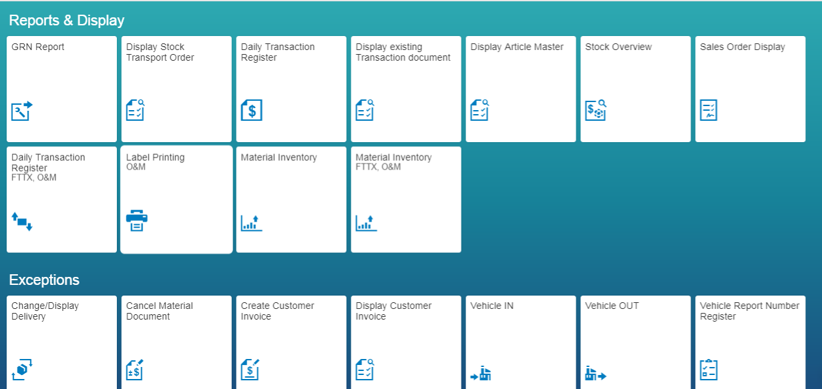
Role: SCM_Executive
1. Purchase Order Display(1/5)
System : SAP Fiori
Based on the user Role, the menu will be populated with Icons corresponding to Role. To view the list of all purchase orders for the JC.

Slide 12
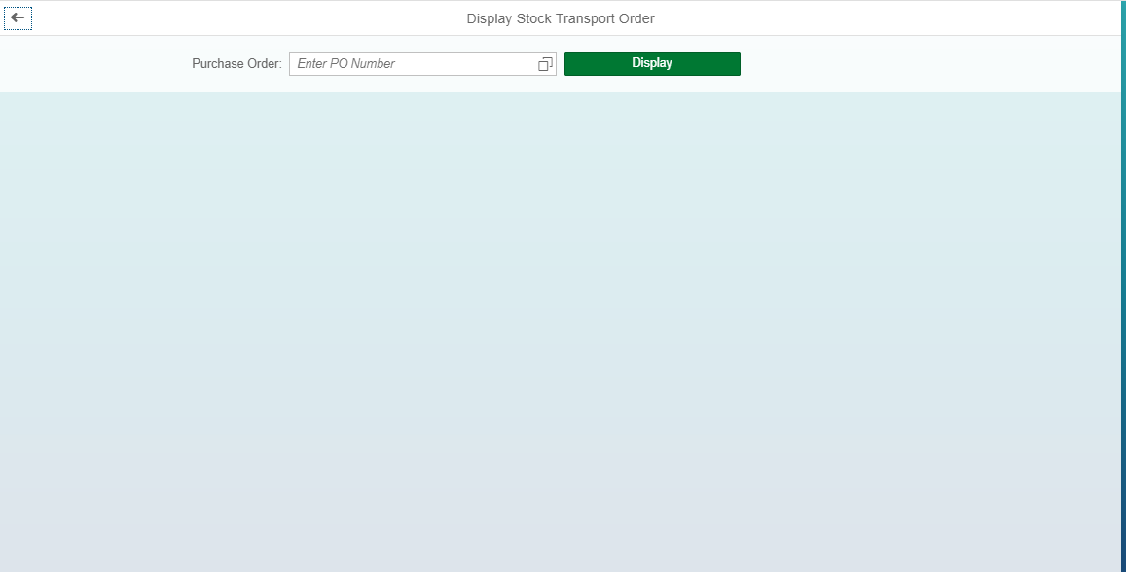
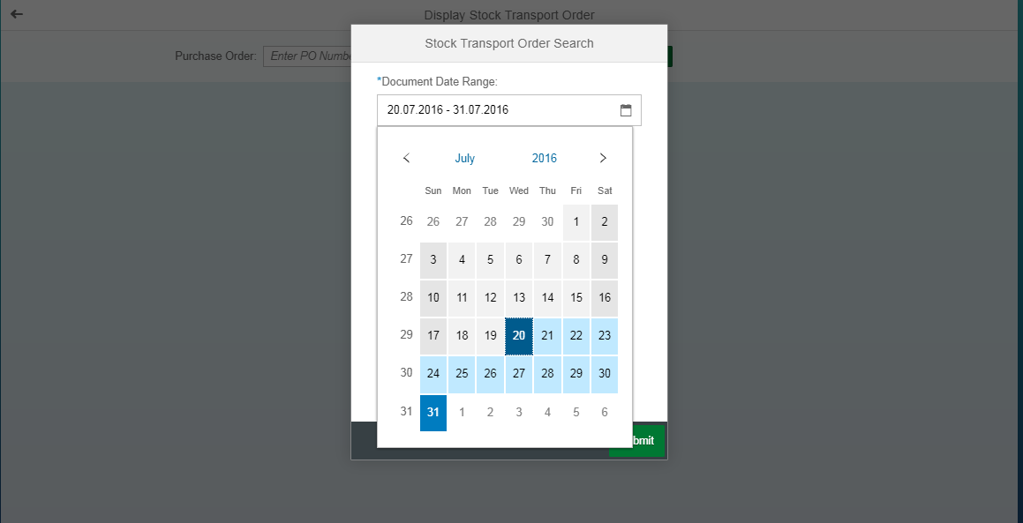
Role: SCM_Executive
1. Purchase Order Display(2/5)
System : SAP Fiori
The user will see a list of all the pending receipts. User can tap on the icon at end of box to select the date range, post which the list of Purchase Order created in that date range as shown in next slide.

Slide 13
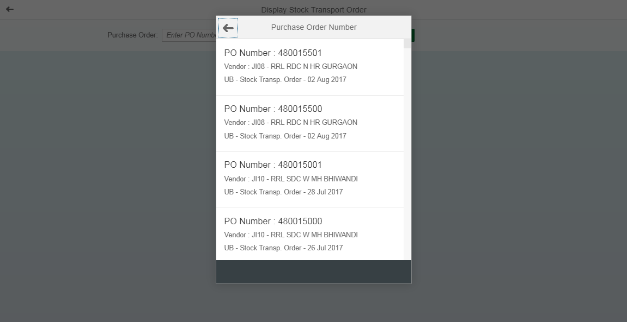
Role: SCM_Executive
1. Purchase Order Display(3/5)
System : SAP Fiori
Date range is selected and basis which the list of all Purchase Orders is displayed.

Slide 14
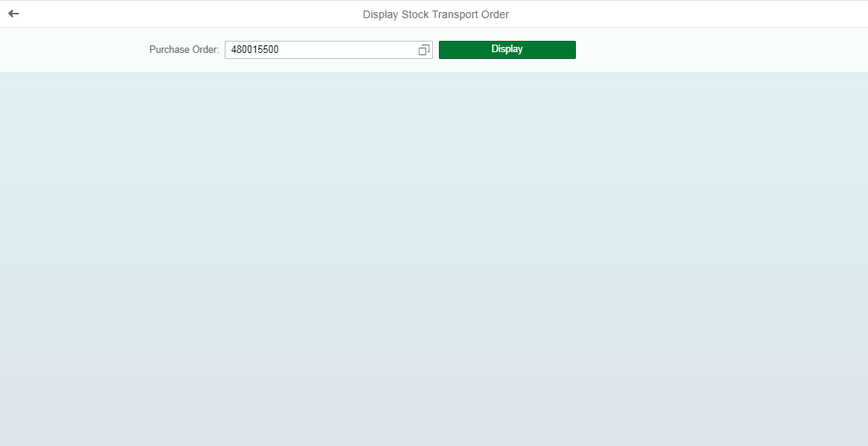
Role: SCM_Executive
1. Purchase Order Display(4/5)
System : SAP Fiori
1
2
1
PO is either entered manually or selected from the list as in earlier slide
2
Click on display to see the order details

Slide 15
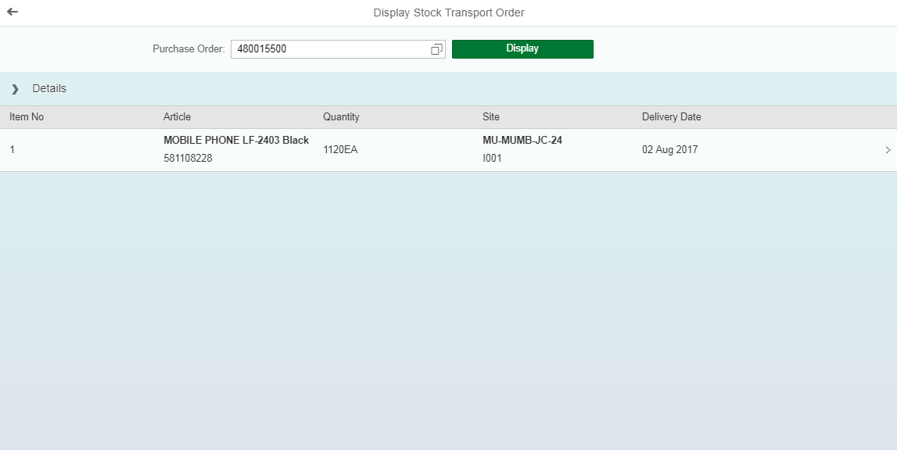
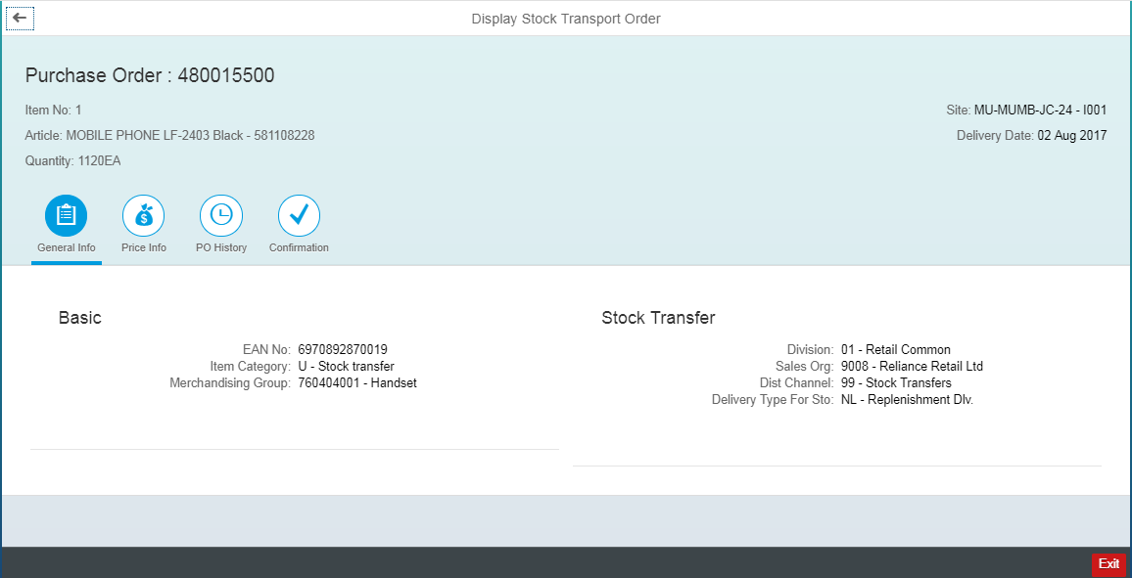
Role: SCM_Executive
1. Purchase Order Display(5/5)
System : SAP Fiori
User can click on any of the line item in order details for more details of order line item

Slide 16
Inbound Movements
Material Receipt

Slide 17
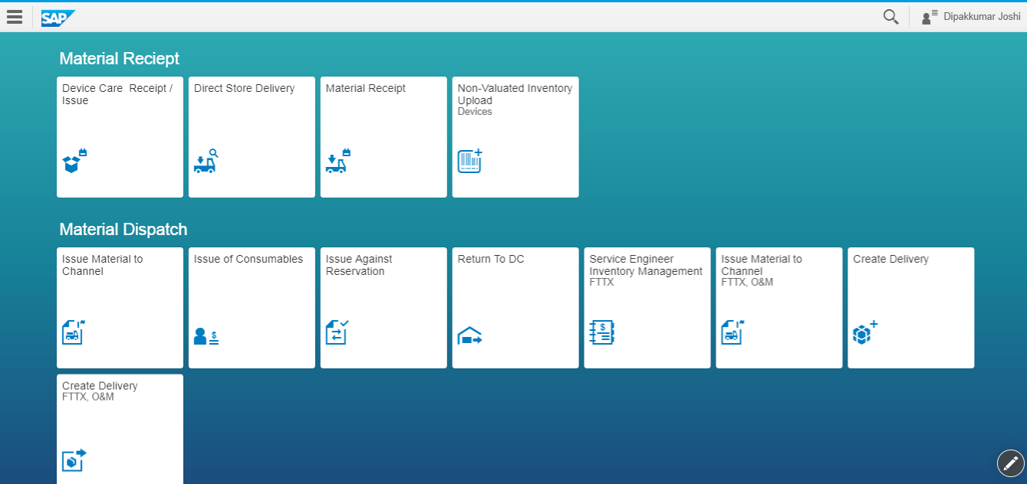
Role: SCM_Executive
1. Material Receipt(1/7)
System : SAP Fiori
Based on the user Role, the menu will be populated with Icons corresponding to Role. For material receipt, click on the icon as highlighted above.

Slide 18
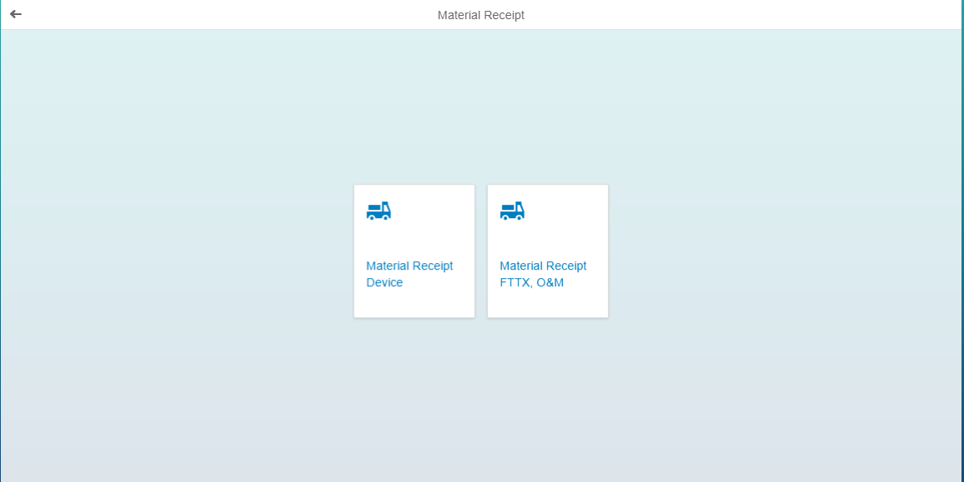
Role: SCM_Executive
1. Material Receipt(2/7)
System : SAP Fiori
Post selection of Material Receipt from Home screen, user needs to select the corresponding tile based on the type of material ( The selected area is for devices(447)).

Slide 19
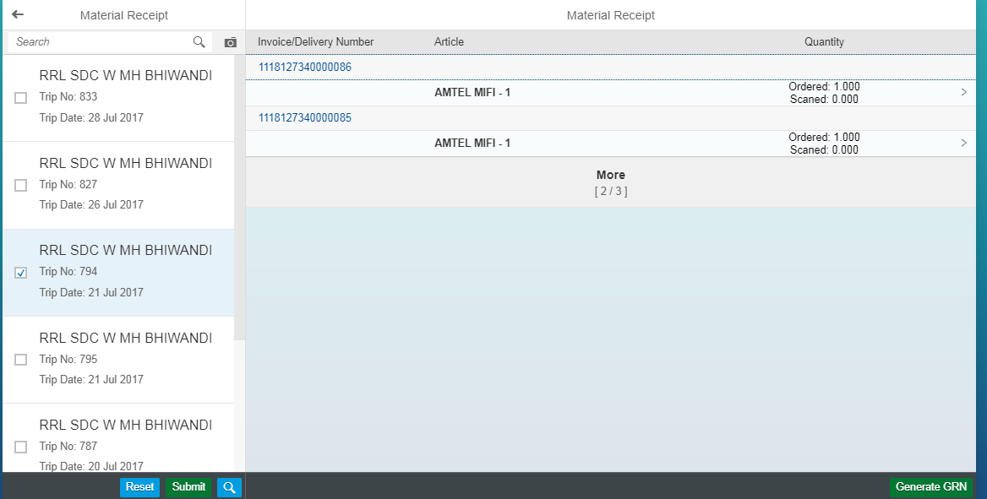
Role: SCM_Executive
1. Material Receipt(3/7)
System : SAP Fiori
1
The user will see a list of all the pending receipts. User can search a specific from the search bar.
4
1
2
The user can select the specific Trip by clicking on the checkbox,
2
3
A user can select multiple trips at a time.
4
The list of all articles in that trip will be visible to user. For more details, user can click on the arrow as highlighted.
3
Source location of Material – RRL DC
A trip is created for dispatch from DC to JC
The date on which trip is created

Slide 20
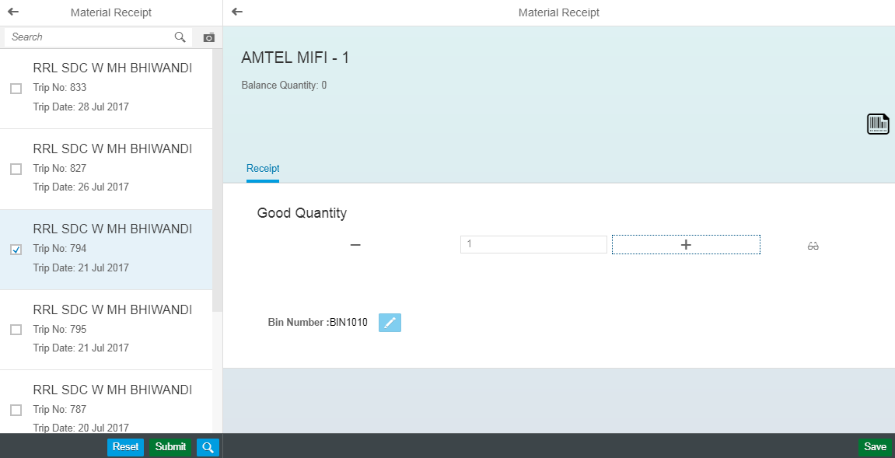
Role: SCM_Executive
1. Material Receipt(4/7)
System : SAP Fiori
1
Click on the icon as highlighted to scan material codes(MSN/Serial Number) and receive Material
2
2
This option is used by Tablet/Smartphone users to use device camera as scanner for receiving material.
4
1
3
3
View the scanned Serial Numbers/MSNs to verify.
4
If any discrepancies found while viewing data/user wish to remove some received material from the scanned list, this icon highlighted can be used

Slide 21
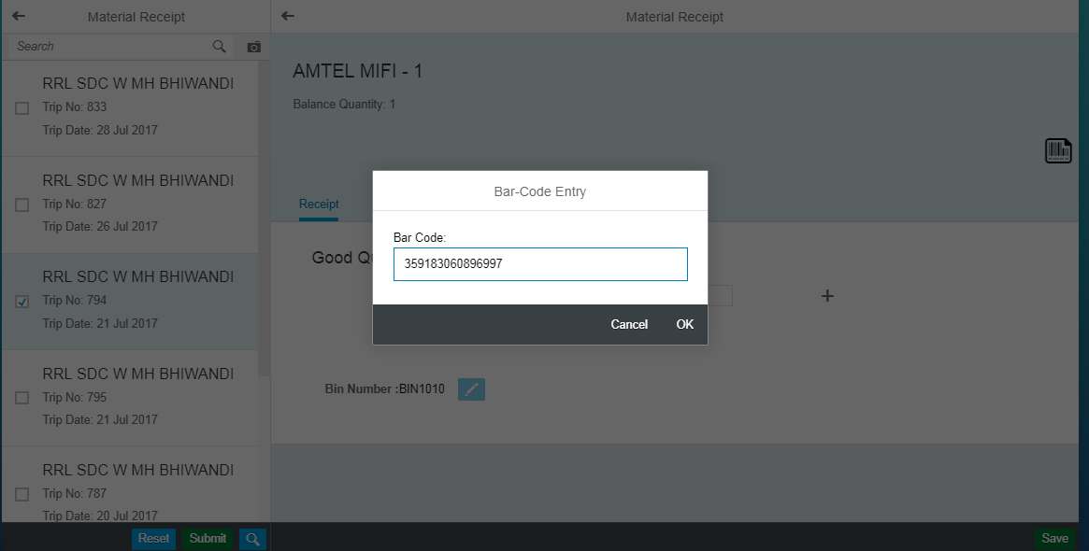
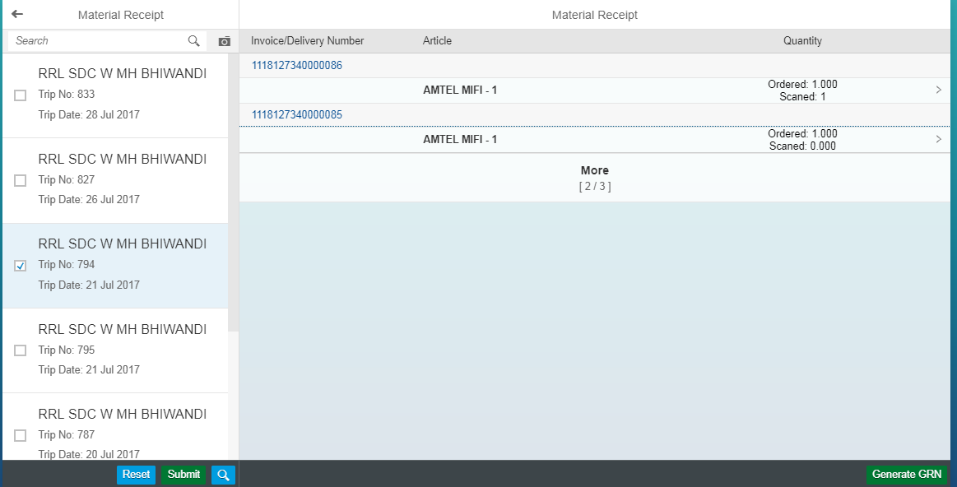
Role: SCM_Executive
1. Material Receipt(5/7)
System : SAP Fiori
Scanned Quantity updated

Slide 22
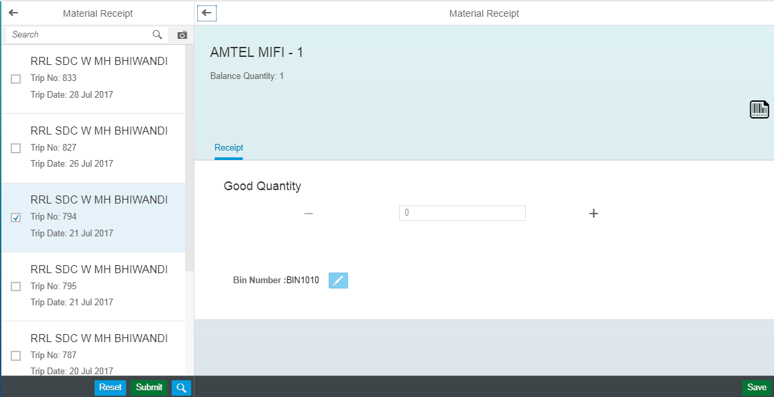
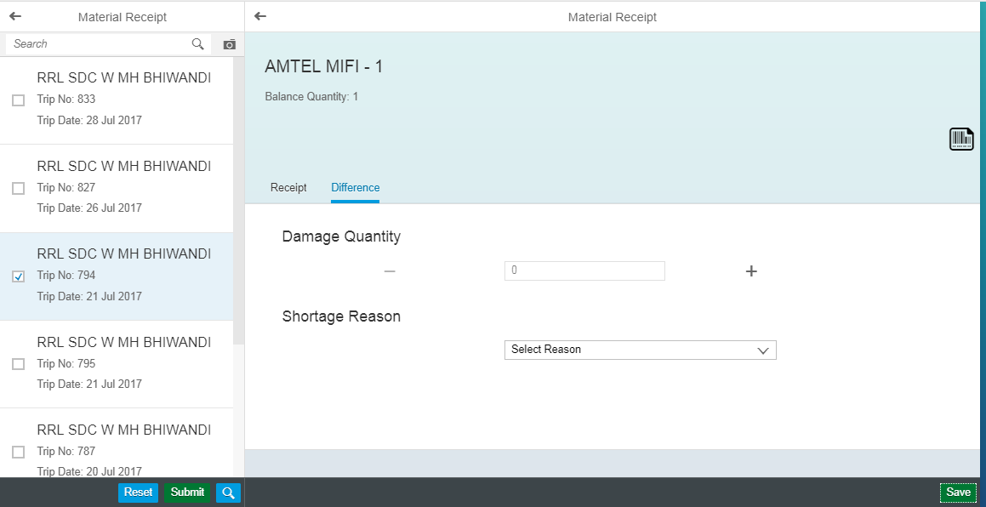
Role: SCM_Executive
1. Material Receipt(6/7)
System : SAP Fiori
Click on the Save to add material receipt under damaged category
2
Select the reason for shortages
1

Slide 23
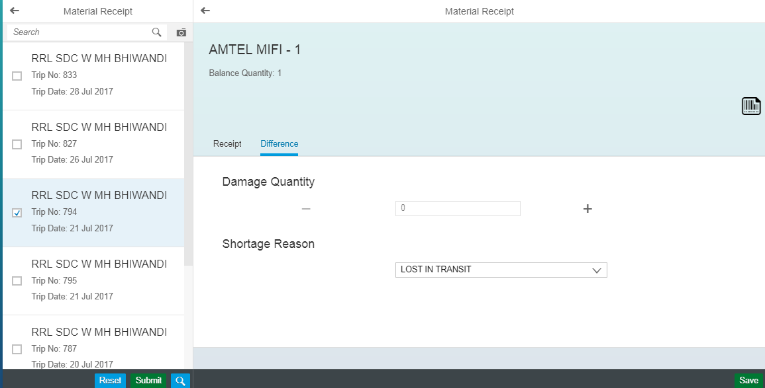
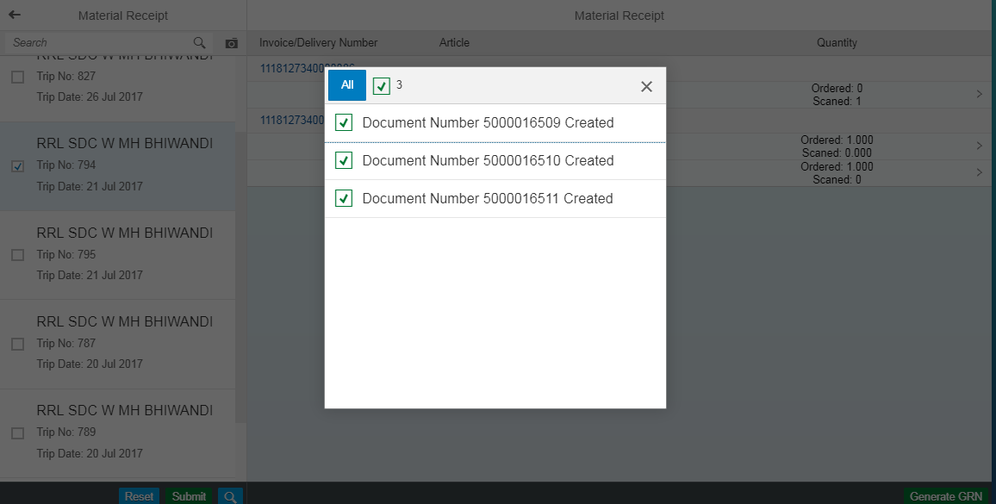
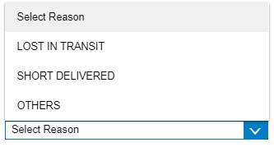
Role: SCM_Executive
1. Material Receipt(7/7)
System : SAP Fiori
1
2
1
Select reason for shortages
2
Click on save button to submit the material receipt
3
Material receipt completed.

Slide 24
Within JC Process
Create/change Reservation
Device care Receipt / Issue
De-boxing application
SIM Dekitting
Issue Materials Consumables
Issue Materials Non Consumables
Issue Material Against Reservation for 447
MBST - Material Document Reversal
Move Stock Return / Damage Area
Reverse goods issue
Service Enginner Inventory Management
Label Printing O&M
Swap Stock (inventory movement from JIO Retail to Retail)

Slide 25
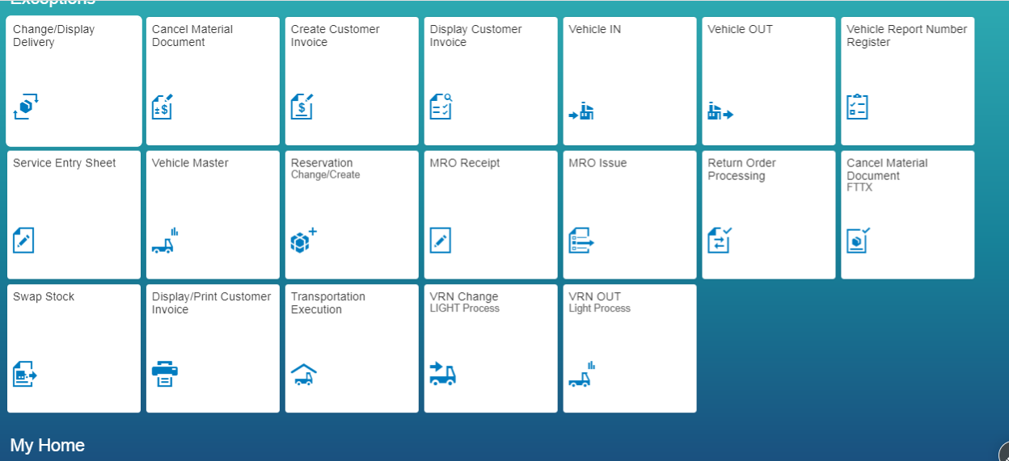
Role:FC&A Executive
1. Create Reservation(1/9)
System : SAP Fiori
To reserve the stocks against orders placed by channel partners or for within location transfers

Slide 26
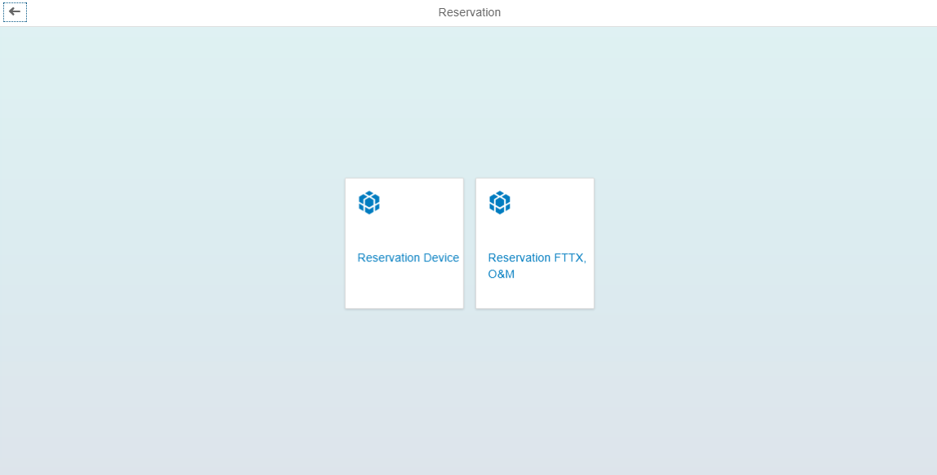
Role:FC&A Executive
1. Create Reservation(2/9)
System : SAP Fiori
For reservation of stocks for 447 click on highlighted tile. For reservation of stocks in P91 click on second tile.

Slide 27
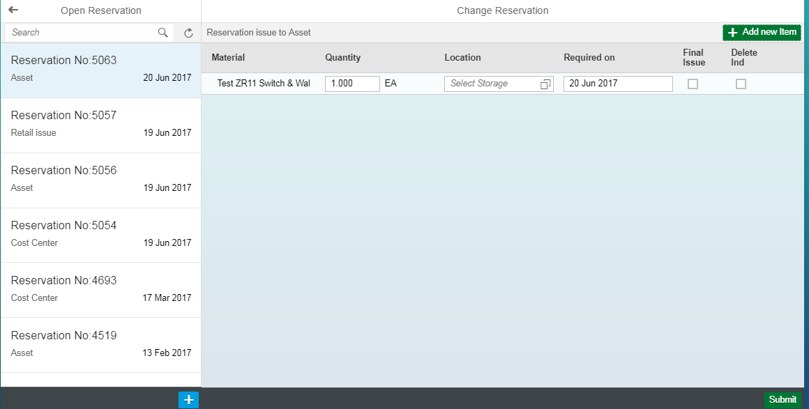
Role:FC&A Executive
1. Create Reservation(3/9)
System : SAP Fiori
The left pane shows the list of reservations, one needs to be selected(first option is default selection) post which the details are visible for material. To proceed to next screen, click on the icon on right end of highlighted area to see list of location.

Slide 28
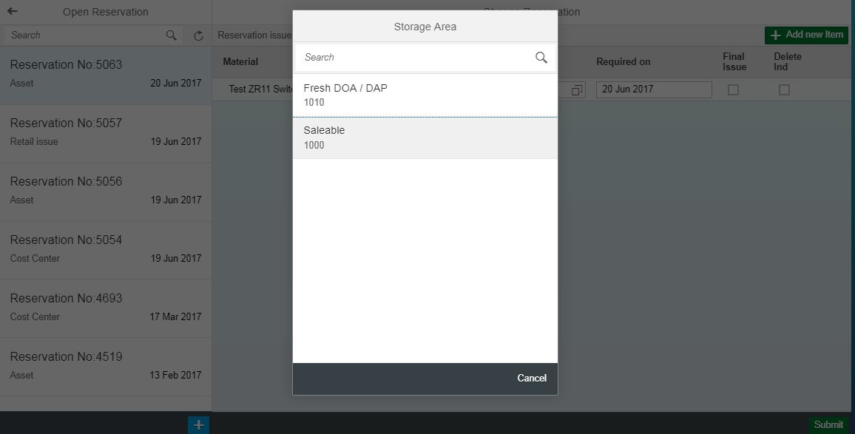
Role:FC&A Executive
1. Create Reservation(4/9)
System : SAP Fiori
Select the relevant storage location from the list (selected one will be highlighted in grey color as in highlighted area shown above.

Slide 29
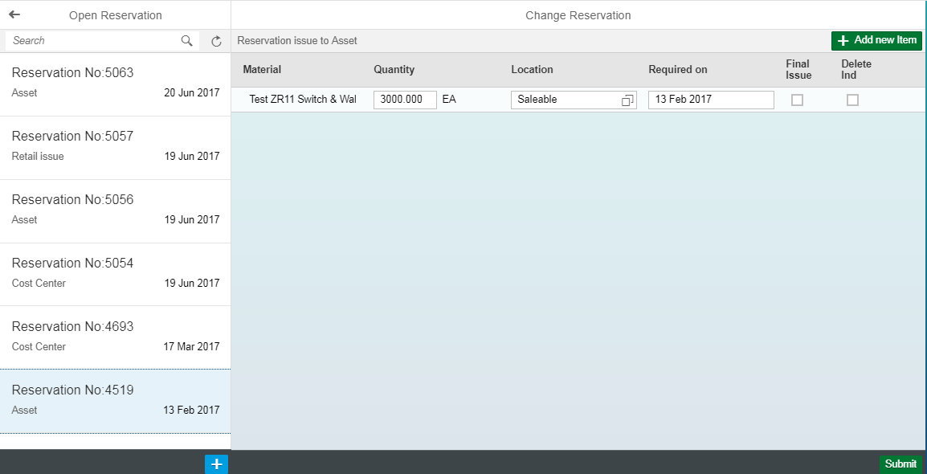
Role:FC&A Executive
1. Create Reservation(5/9)
System : SAP Fiori
To add materials in the reservation click on Add New Item Button as highlighted above.

Slide 30
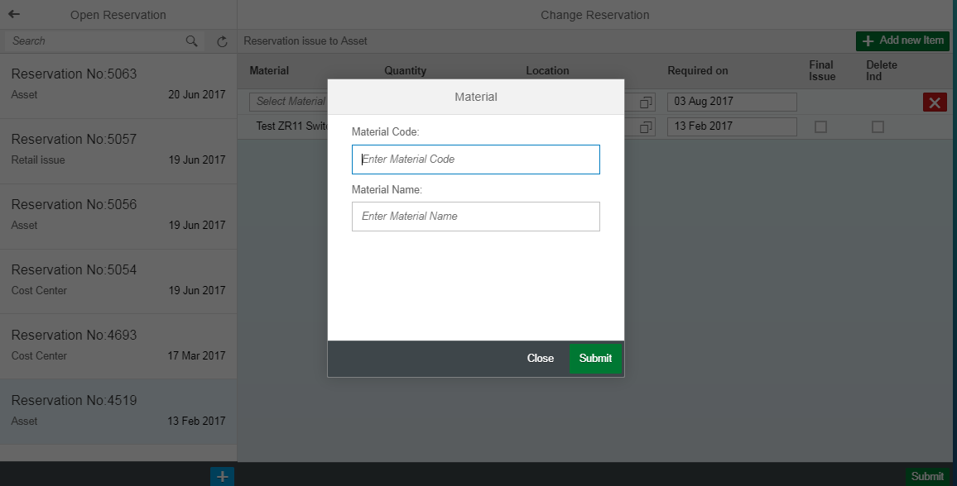
Role:FC&A Executive
1. Create Reservation(6/9)
System : SAP Fiori
Material can be searched by material code OR by material name or a part of it, on submission of which list will be displayed as in the following screenshot.

Slide 31
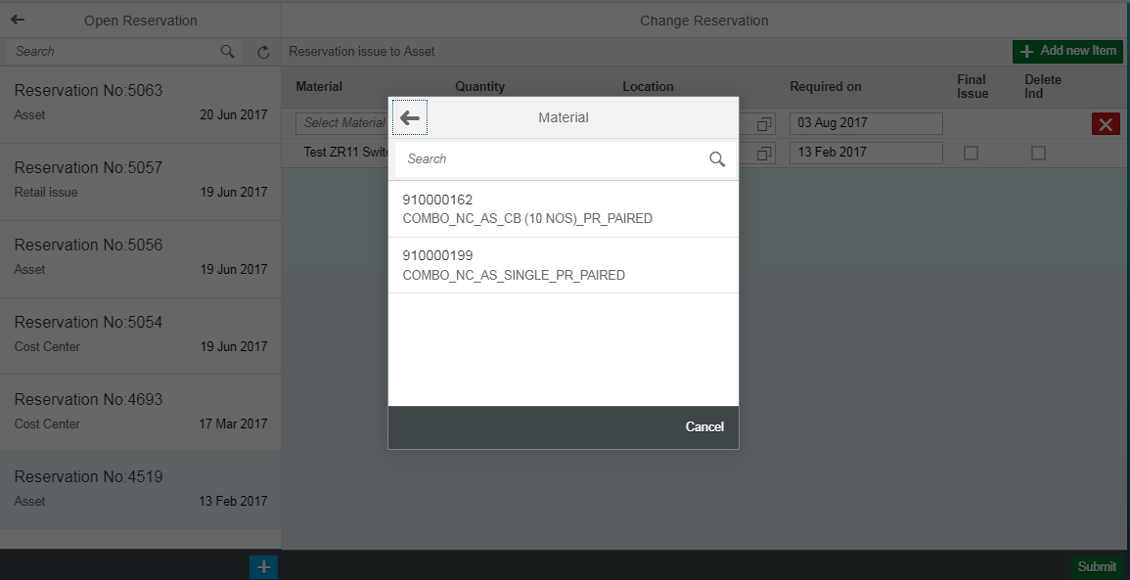
Role:FC&A Executive
1. Create Reservation(7/9)
System : SAP Fiori
The above screen shows list of materials as per search criteria.

Slide 32
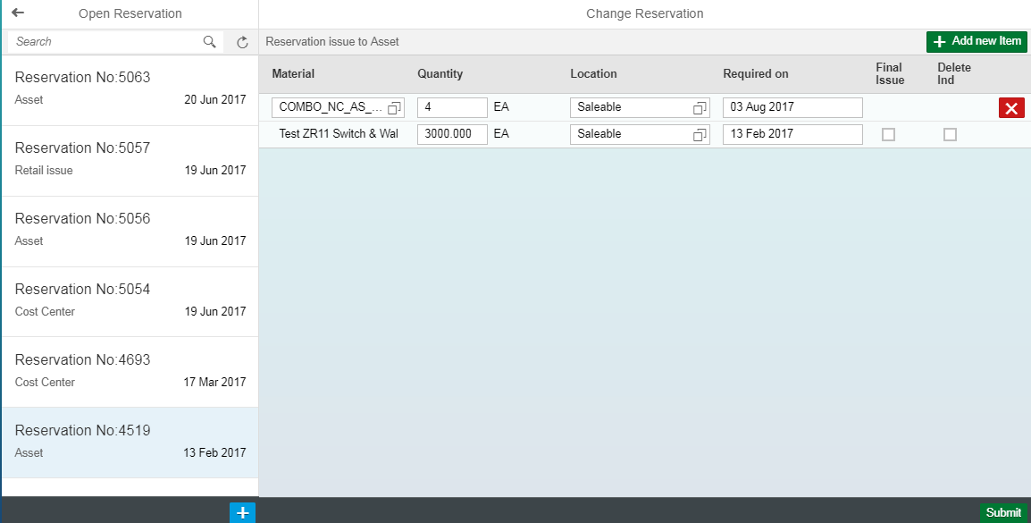
Role:FC&A Executive
1. Create Reservation(8/9)
System : SAP Fiori
The material is now added in the reservation list. Post verification of the list, user can click on submit button at the right bottom of the screen and create reservation.

Slide 33
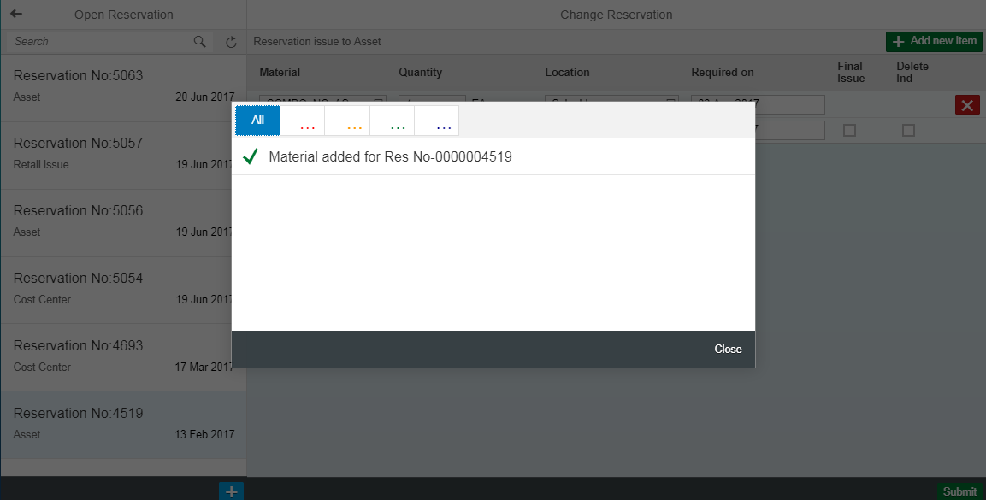
Role:FC&A Executive
1. Create Reservation(9/9)
System : SAP Fiori
Reservation is created.

Slide 34
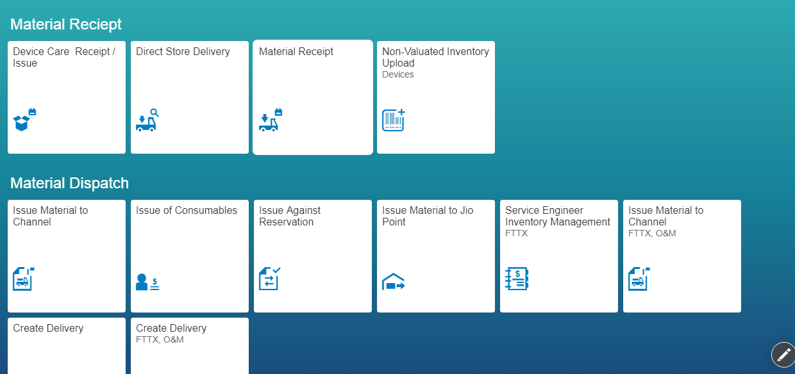
Role : SCM Executive
2. Device Care Receipt/Issue(1/4)
System : SAP Fiori
To receive and issue spares against the requests from DRS

Slide 35
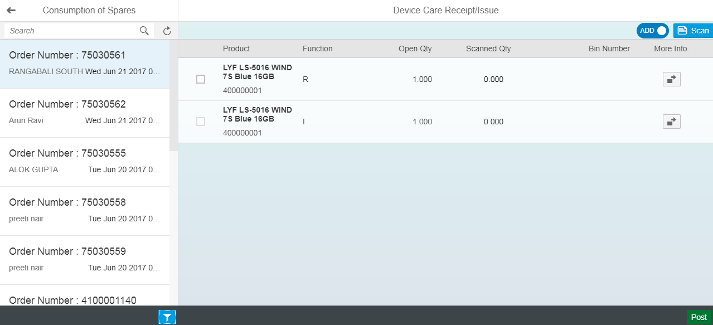
Role : SCM Executive
2. Device Care Receipt/Issue(2/4)
System : SAP Fiori
Order is selected from the left pane, products listed in the order no. will be displayed. Product information can be viewed upon click on the icon (highlighted on the right side)

Slide 36
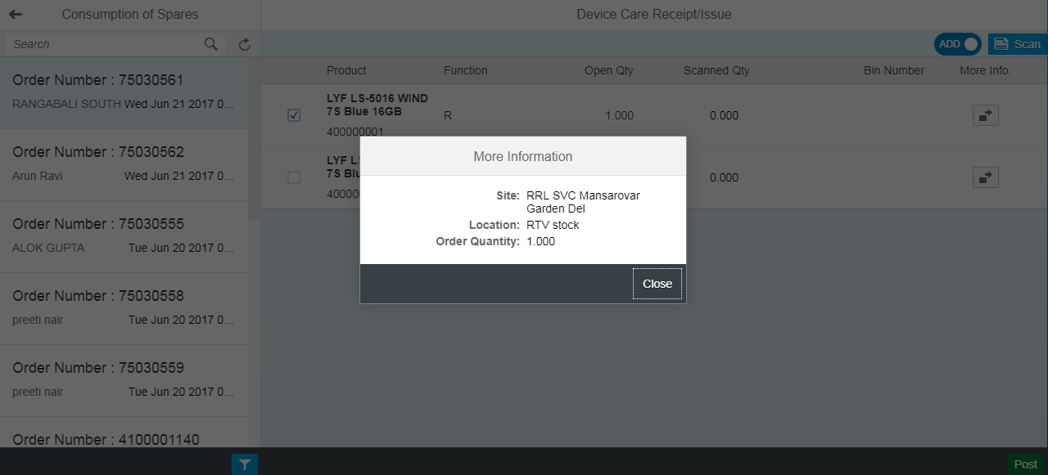
Role : SCM Executive
2. Device Care Receipt/Issue(3/4)
System : SAP Fiori
Product description is displayed.

Slide 37
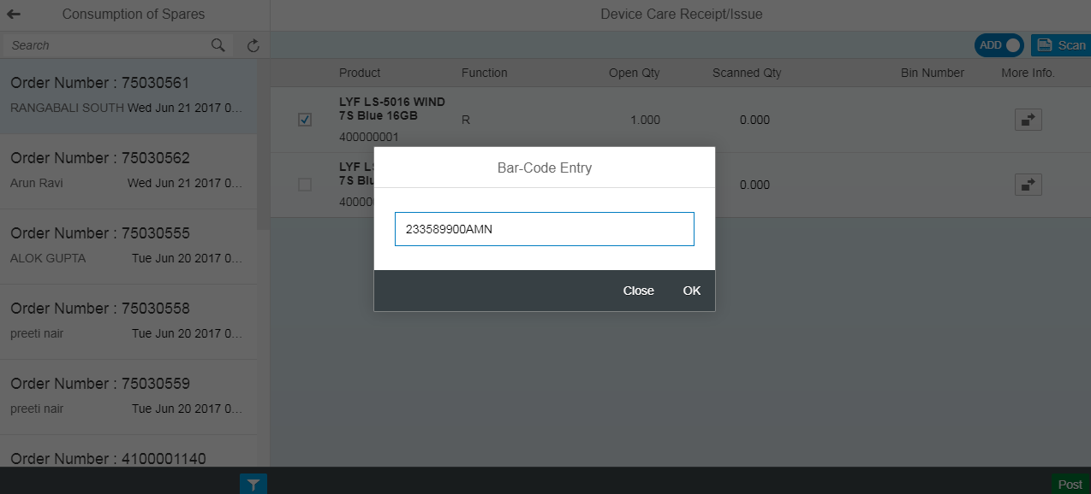
Role : SCM Executive
2. Device Care Receipt/Issue(4/4)
System : SAP Fiori
2
1
3
First to select the material from list (1), then click on scan button on top right (2), and Bar code can be posted of the required material by clicking the Post button at the bottom (3).

Slide 38
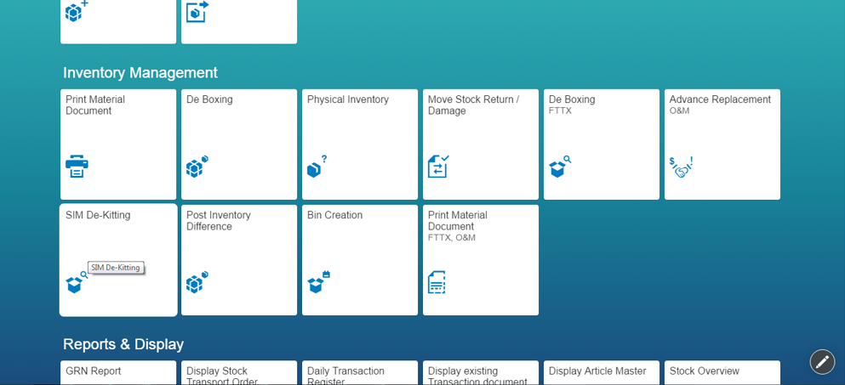
Role : SCM Executive
4. SIM De-kitting(1/3)
System : SAP Fiori
2
To split the packed SIM into single SIM for issuing against purchase orders to channel partners.

Slide 39
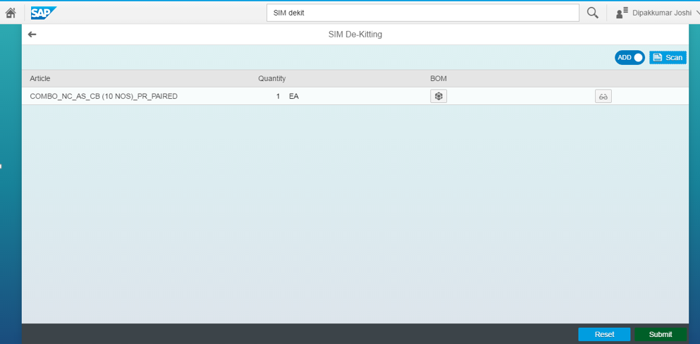
Role : SCM Executive
4. SIM De-kitting(2/3)
System : SAP Fiori
Click on scan button highlighted at the top to scan the serial no. of kitted SIM. Article is then displayed as above. Click on submit button at the right bottom to de-kit the SIM.

Slide 40
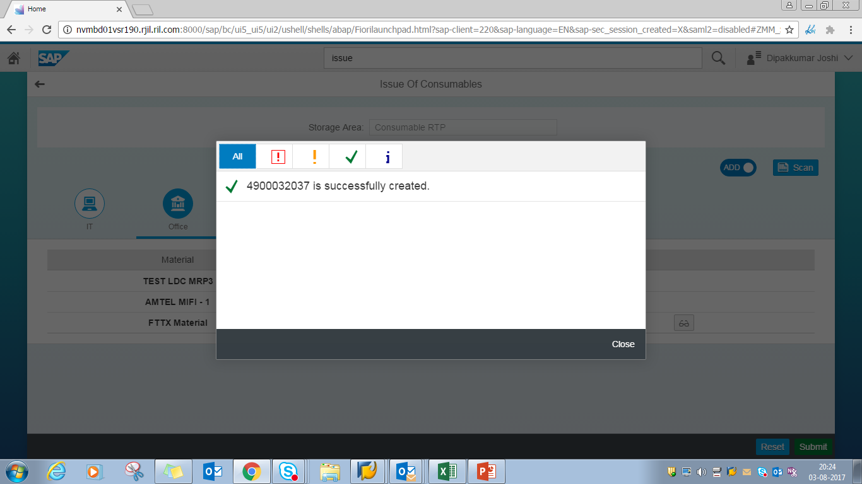
Role : SCM Executive
4. SIM De-kitting(3/3)
System : SAP Fiori
SIM is de-Kitted. With this the stock quantity of de-kitted SIM is increased and that of packed SIM is reduced.

Slide 41
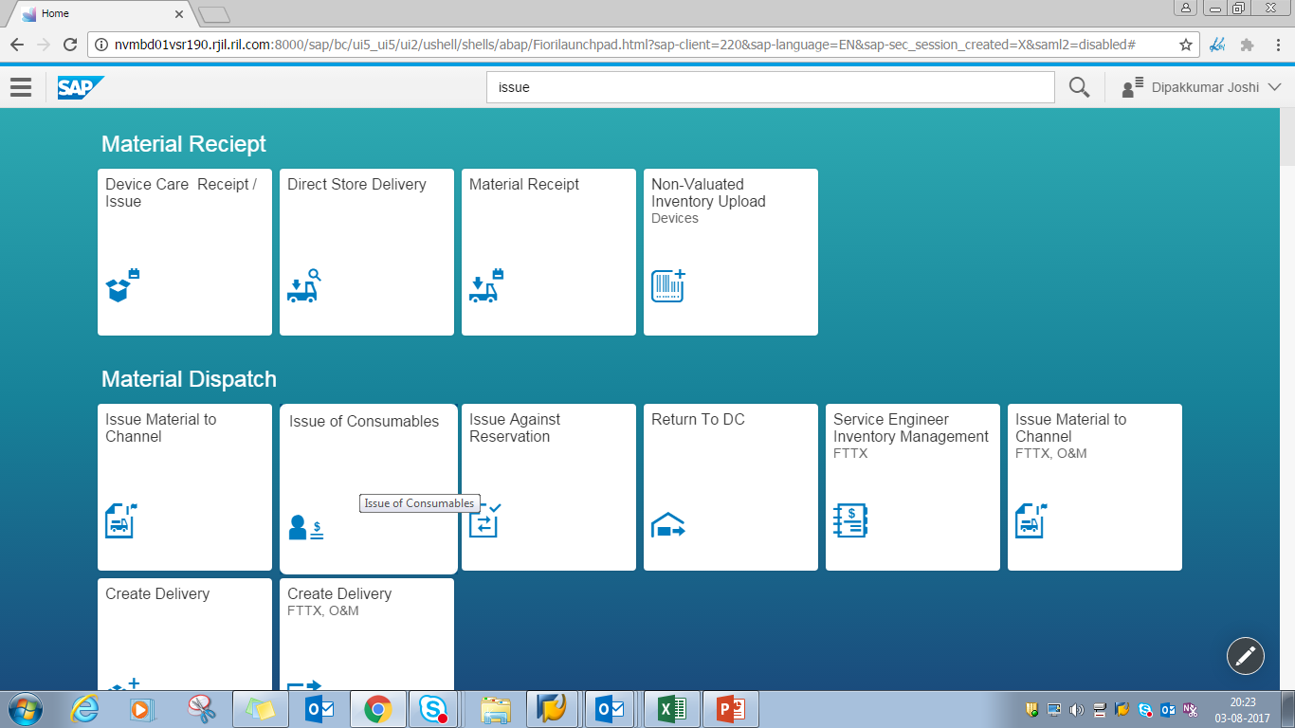
Role : SCM Executive
5. Issue Materials Consumables(1/5)
System : SAP Fiori
To issue consumable materials to respective departments within JC

Slide 42
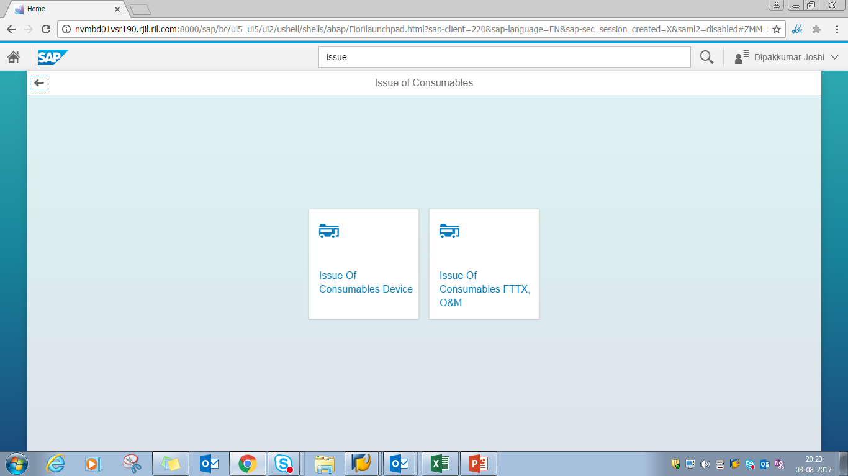
Role : SCM Executive
5. Issue Materials Consumables(2/5)
System : SAP Fiori
JC SCM issues consumables devices (447 server) as well as FTTx (P91 server). Select the right tile appropriately

Slide 43
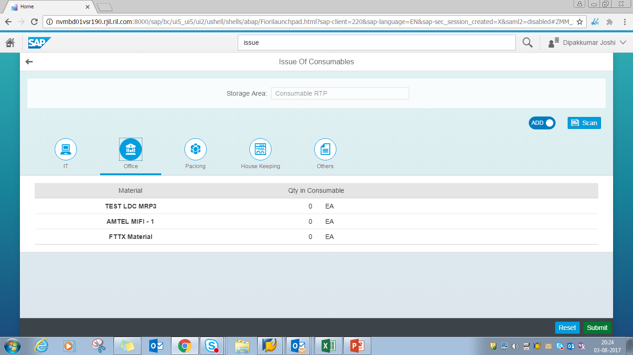
Role : SCM Executive
5. Issue Materials Consumables(3/5)
System : SAP Fiori
Click on scan on top right (highlighted) to scan the material to be issued.

Slide 44
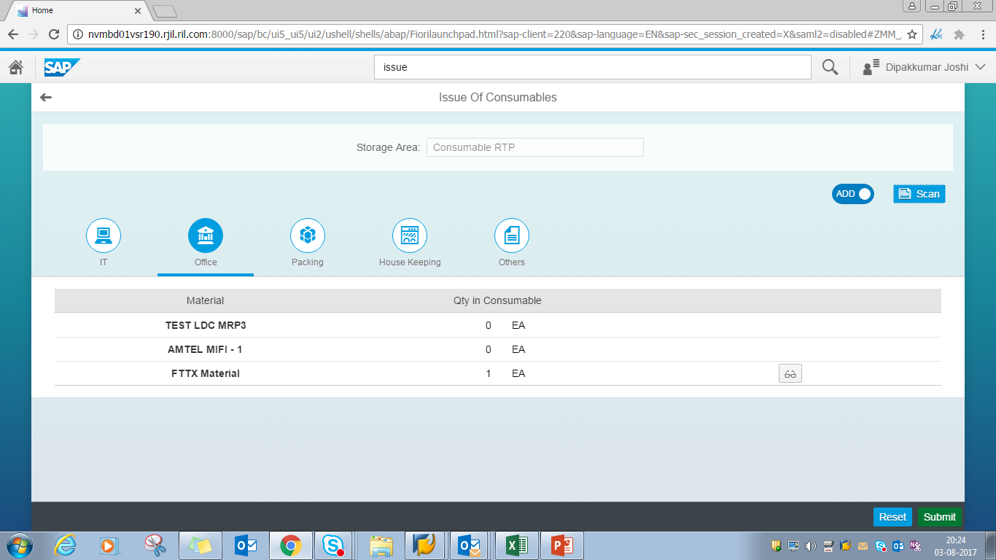
Role : SCM Executive
5. Issue Materials Consumables(4/5)
System : SAP Fiori
Material quantity is increased by 1 (highlighted). Click on Submit to complete the transaction.

Slide 45
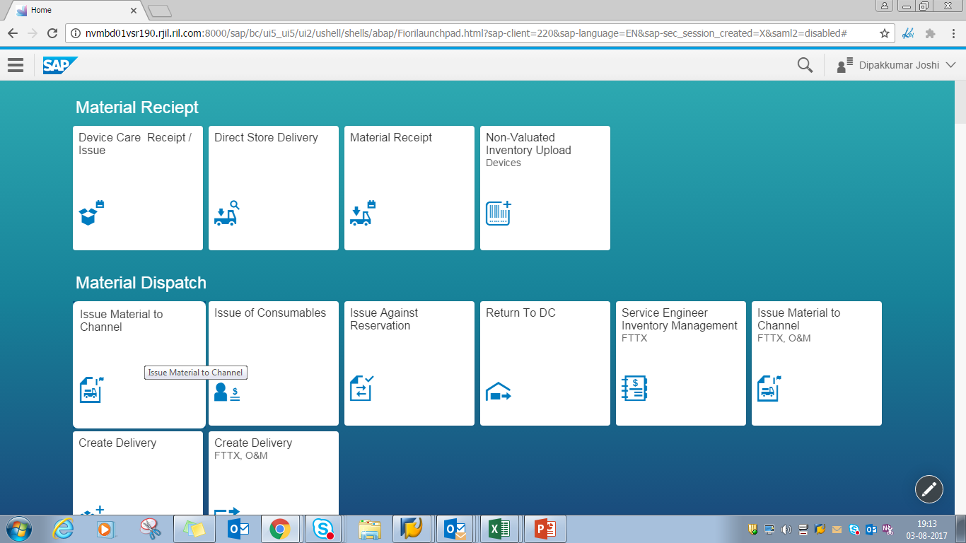
Role : SCM Executive
5. Issue Materials Consumables(5/5)
System : SAP Fiori
To move the stocks from one storage location to other vis. Saleable to damage or saleable to stock return

Slide 46
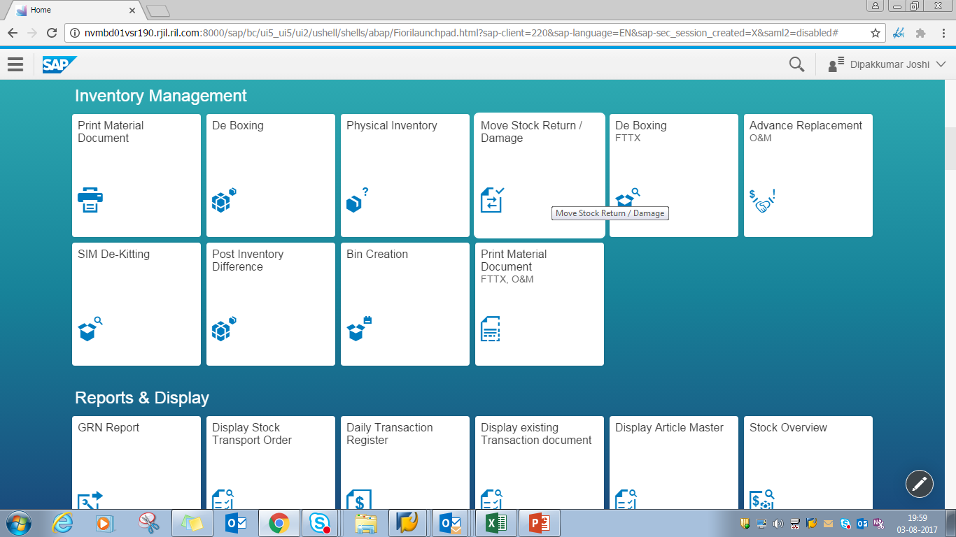
Role : SCM Executive
9. Move Stock Return/Damaged Item(1/4)
System : SAP Fiori
To move the stocks from one storage location to other vis. Saleable to damage or saleable to stock return

Slide 47
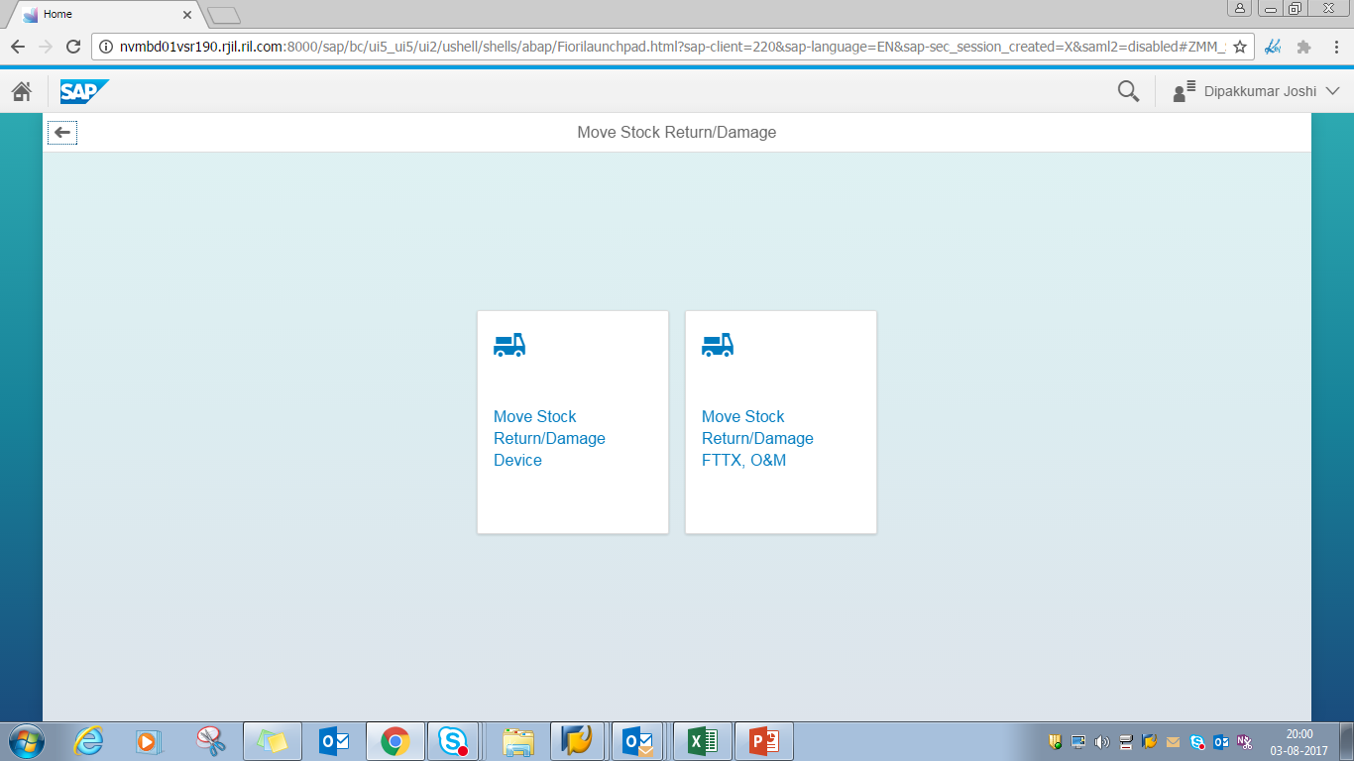
Role : SCM Executive
9. Move Stock Return/Damaged Item(2/4)
System : SAP Fiori
To move stocks from one storage location to another, click on the highlighted tile for Device or the tile next to highlighted one for FTTx and O&M.

Slide 48
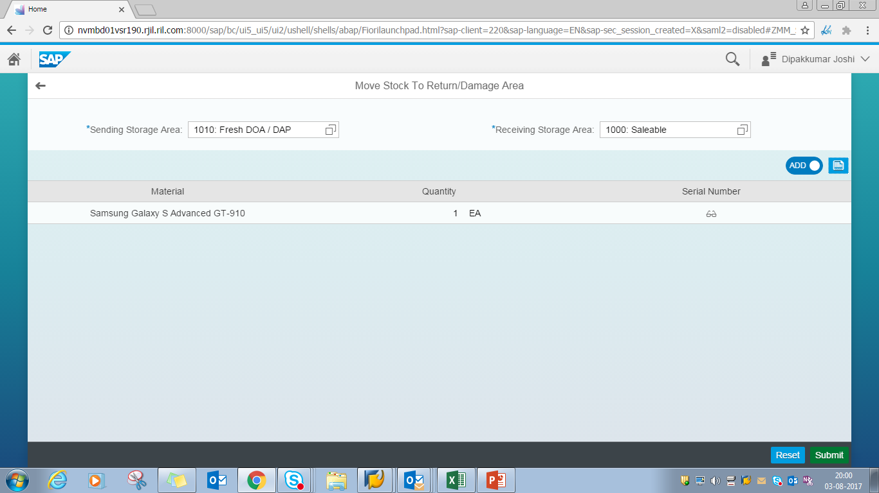
Role : SCM Executive
9. Move Stock Return/Damaged Item(3/4)
System : SAP Fiori
1
Select sending storage area from the drop down which is listed by clicking on the icon in right of selected area
1
2
3
2
Select Receiving storage area from the drop down which is listed by clicking on the icon in right of selected area
4
3
Click on the highlighted icon to scan the bar code of material to be transferered to some another location.
5
4
The article details are listed
5
Post validation of details, user submits for Stock Transfer Document

Slide 49
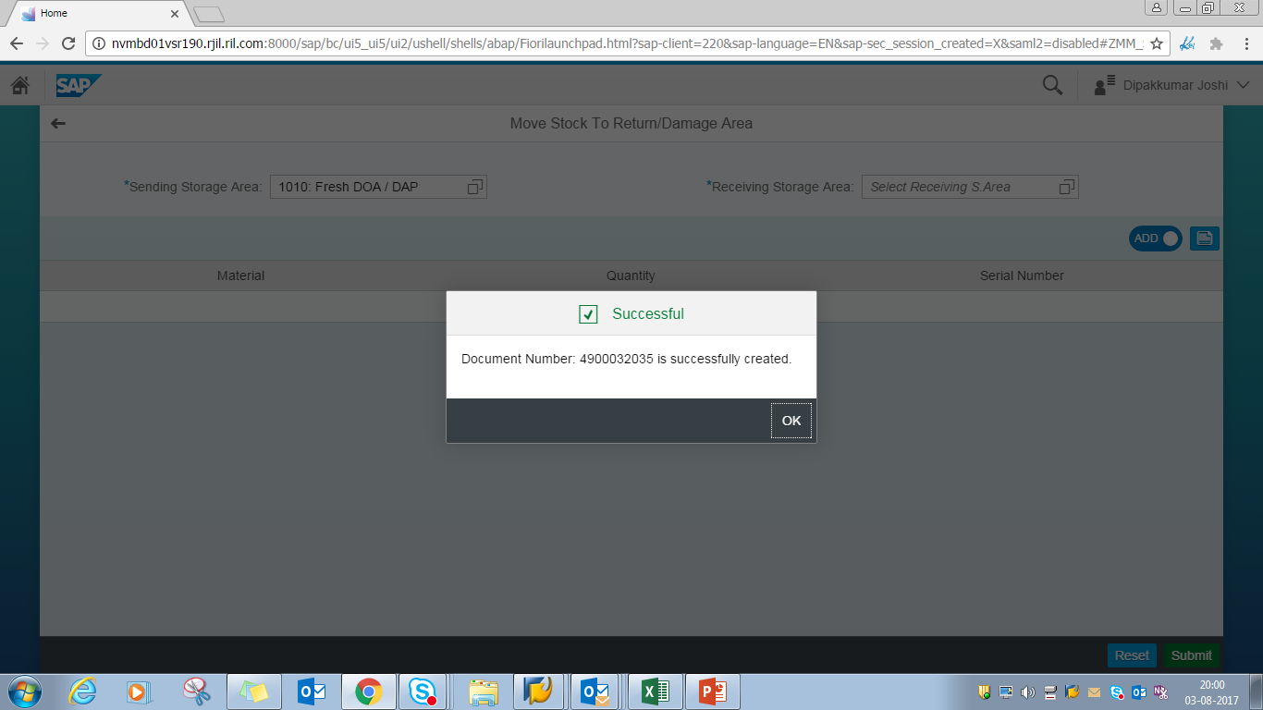
Role : SCM Executive
9. Move Stock Return/Damaged Item(4/4)
System : SAP Fiori
Confirmation popup for successful creation of Stock Transfer Document

Slide 50
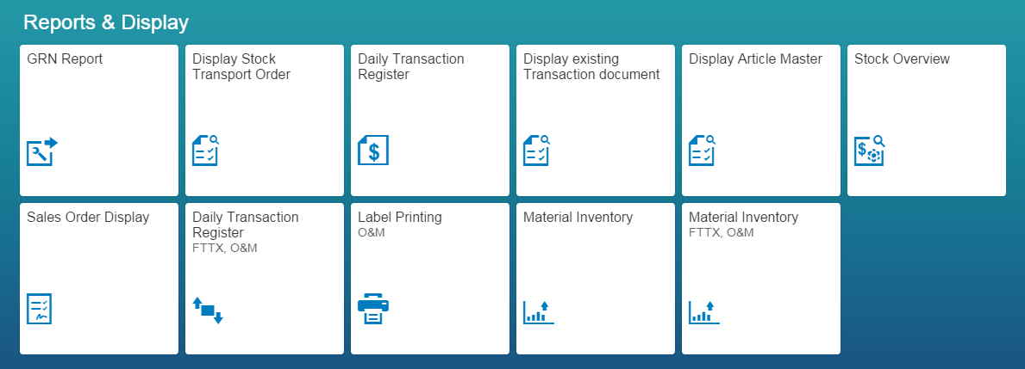
Role : SCM Executive
12. Label Printing O&M(1/4)
System : SAP Fiori
To print labels for return dispatches from JC to DC. Label consists of Return doc no, date, Material desc, barcode information

Slide 51
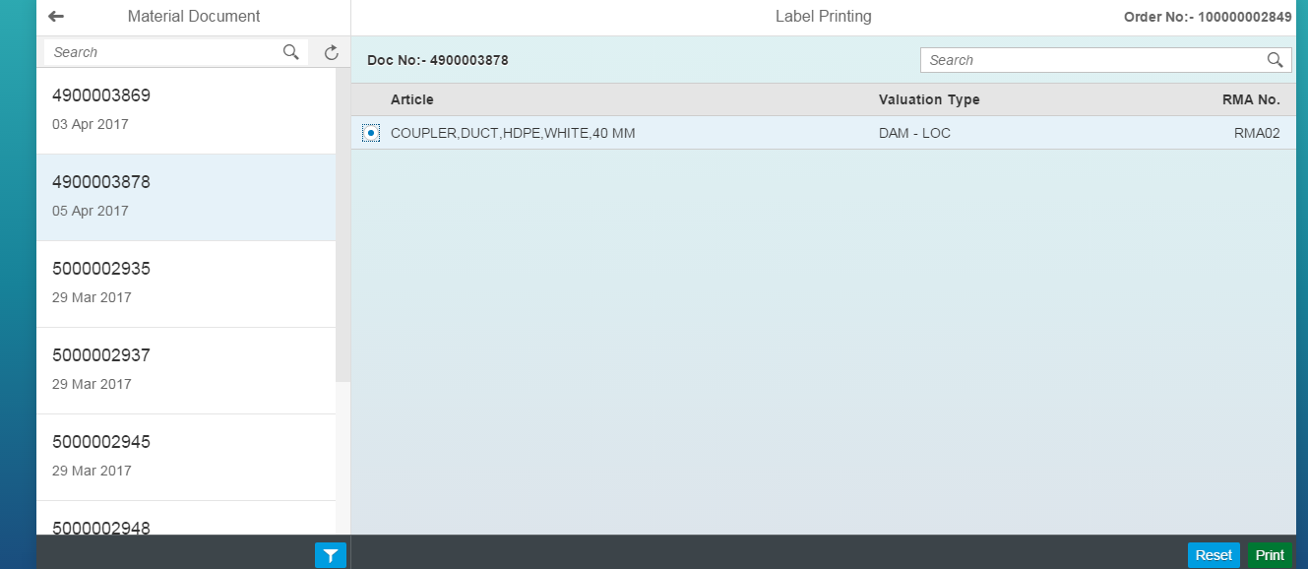
Role : SCM Executive
12. Label Printing O&M(2/4)
System : SAP Fiori
Select the material document from the left pane to be printed. Click on filter button to select material documents for select date-range

Slide 52
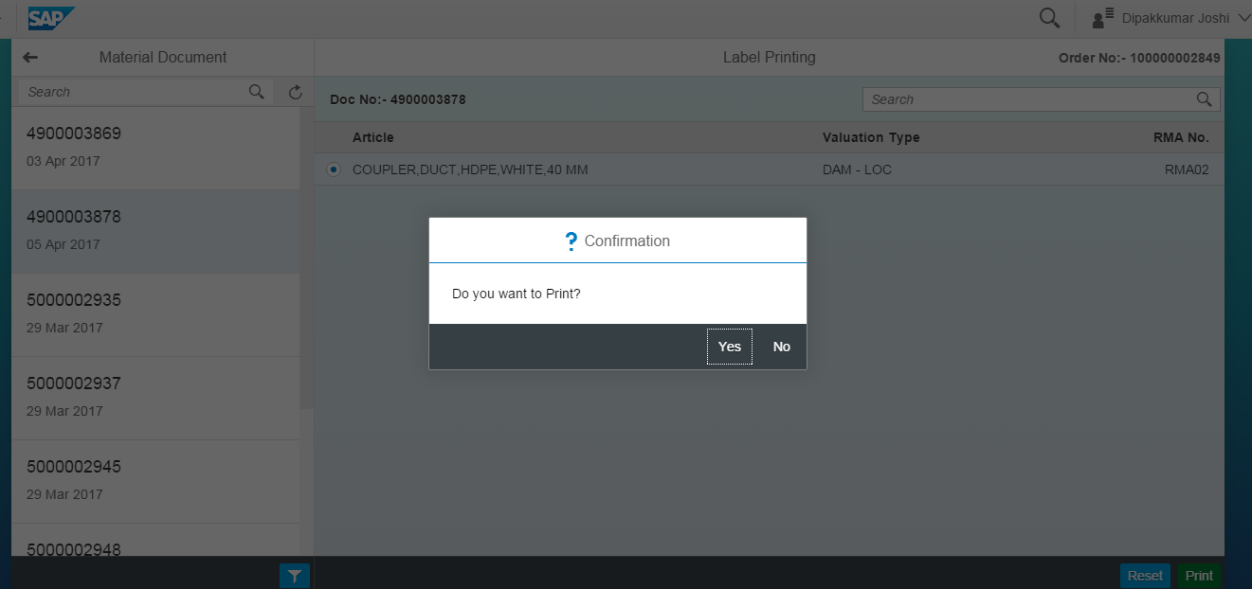
Role : SCM Executive
12. Label Printing O&M(3/4)
System : SAP Fiori
Confirmation to print the label

Slide 53
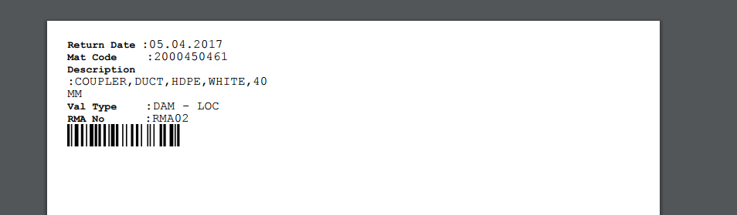
Role : SCM Executive
12. Label Printing O&M(4/4)
System : SAP Fiori
View & verify the label before printing

Slide 54
Physical Inventory Verification
Physical Inventory Proposal
Physical Inventory Count

Slide 55
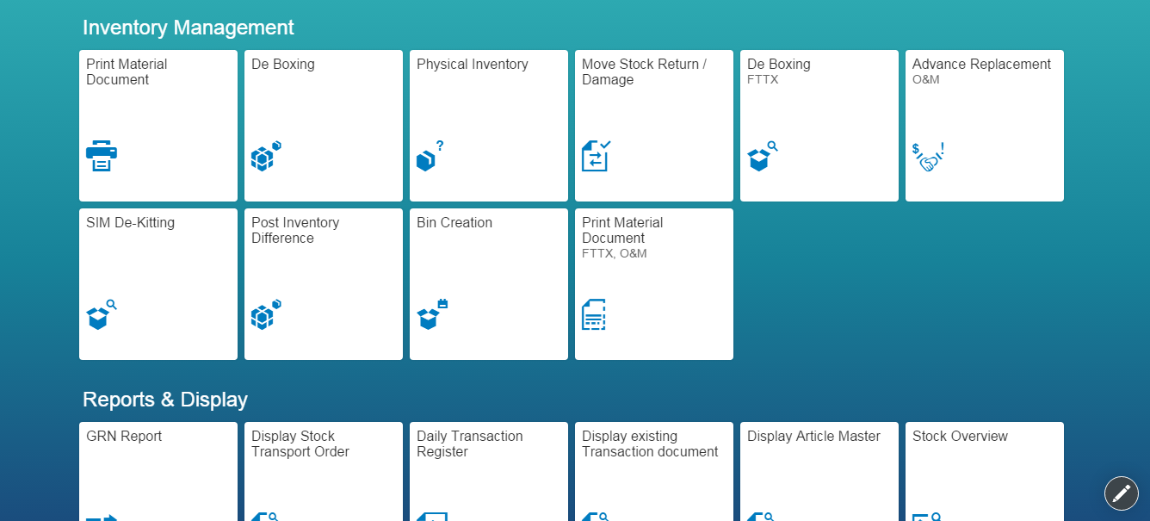
Role : SCM Executive
1. Physical Inventory Proposal(1/12)
System : SAP Fiori
Allows perform physical inventory reconciliation vis-a-vis system stock

Slide 56

Role : SCM Executive
1. Physical Inventory Proposal(2/12)
System : SAP Fiori
JC user can perform physical inventory verification for devices (447 server) as well for FTTx and O&M (P91 server). Select the tile accordingly

Slide 57
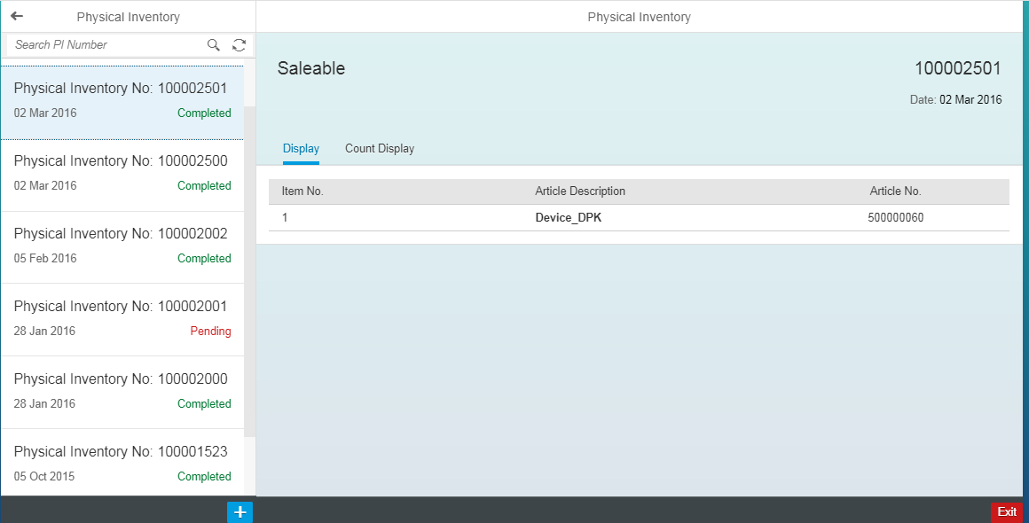
Role : SCM Executive
1. Physical Inventory Proposal(3/12)
System : SAP Fiori
Click on plus button to initiate the physical inventory verification process. Existing transactions are listed in left pane for further verification

Slide 58
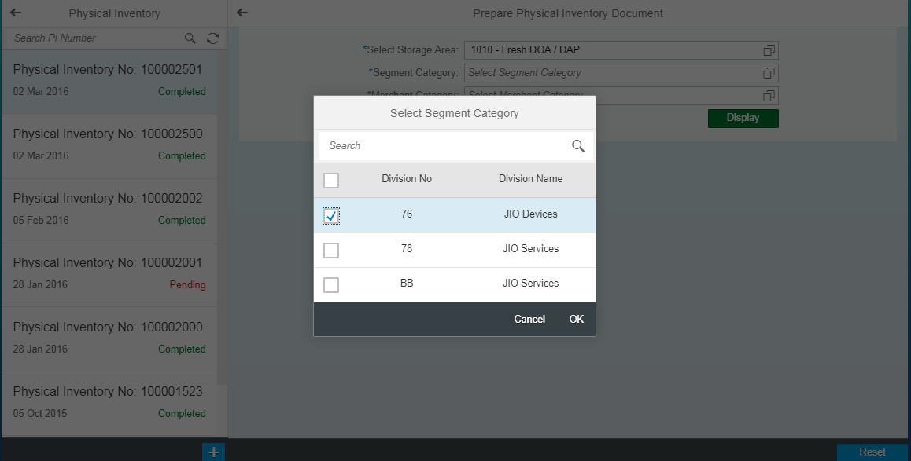
Role : SCM Executive
1. Physical Inventory Proposal(4/12)
System : SAP Fiori
Select material segment category

Slide 59

Role : SCM Executive
1. Physical Inventory Proposal(5/12)
System : SAP Fiori
Select material merchant category (these is as per material master maintained by business)

Slide 60

Role : SCM Executive
1. Physical Inventory Proposal(6/12)
System : SAP Fiori
Screen showing the Segment and Merchant category for given inventory document

Slide 61

Role : SCM Executive
1. Physical Inventory Proposal(7/12)
System : SAP Fiori
List of materials in selected category are displayed

Slide 62

Role : SCM Executive
1. Physical Inventory Proposal(8/12)
System : SAP Fiori
Physical inventory document successfully created

Slide 63

Role : SCM Executive
1. Physical Inventory Proposal(9/12)
System : SAP Fiori
View the document

Slide 64

Role : SCM Executive
1. Physical Inventory Proposal(10/12)
System : SAP Fiori
Click on ‘Count’ to enter the count as per physical verification in storage location

Slide 65

Role : SCM Executive
1. Physical Inventory Proposal(11/12)
System : SAP Fiori
Key-in the count as per physical verification and click on ‘submit’ button

Slide 66

Role : SCM Executive
1. Physical Inventory Proposal(12/12)
System : SAP Fiori
Physical verification count successfully created

Slide 67

Role : SCM Executive
2. Physical Inventory Count
System : SAP Fiori
Document completed

Slide 68
Internal Movements
Site to Site Transfer
STO create

Slide 69

Role : SCM Executive
1. Return to DC (Site to Site transfer) (1/5)
System : SAP Fiori
Allows JC to return material from one location to other location (site to site)

Slide 70

Role : SCM Executive
1. Return to DC (Site to Site transfer) (2/5)
System : SAP Fiori

Slide 71

Role : SCM Executive
1. Return to DC (Site to Site transfer) (3/5)
System : SAP Fiori
Select Supplying from and Ship-to site locations here from the drop-down as applicable to JC

Slide 72

Role : SCM Executive
1. Return to DC (Site to Site transfer) (4/5)
System : SAP Fiori
1
Click on scan button to add material
1
2
2
Scan the barcode and click on OK
3
3
Shows the material details.
4
Click on Submit button to proceed
4

Slide 73

Role : SCM Executive
1. Return to DC (Site to Site transfer) (5/5)
System : SAP Fiori

Slide 74

Role : SCM Executive
2. STO create(1/5)
System : SAP Fiori
To create stock transfer order from JC to DC

Slide 75

Role : SCM Executive
2. STO create(2/5)
System : SAP Fiori
Click on Plus button to create a new Stock transport order

Slide 76

Role : SCM Executive
2. STO create(3/5)
System : SAP Fiori
Select Supplying from storage location and Ship-to site and scan the material

Slide 77

Role : SCM Executive
2. STO create(4/5)
System : SAP Fiori
Verify the article and click on Submit button

Slide 78

Role : SCM Executive
2. STO create(5/5)
System : SAP Fiori
Stock transport order created

Slide 79
Outbound Movement
Issue Material to Channel
Create Customer Invoice
Customer Invoice Cancel, Display
Create delivery
Change Delivey : Cancel, Display
Advance Replacement O&M
MRO Receipt
MRO Issue
Sales Order Display
Display/ Print Customer Invoice

Slide 80
Role : SCM Executive
1. Issue Material to channel(1/3)
System : SAP Fiori
To issue stocks against channel partner orders or internal stock transfer orders

Slide 81

Role : SCM Executive
1. Issue Material to channel(2/3)
System : SAP Fiori
1
Select the pending dispatch task from left pane
2
Scan the article bar code
2
3
1
3
On scanning, proceed quantity is updated to 1.
4
Click on submit to complete the transaction
4
List of pending dispatched is shown in left pane.

Slide 82

Role : SCM Executive
1. Issue Material to channel(3/3)
System : SAP Fiori
Dispatch completed with billing.

Slide 83

Role : SCM Executive
2. Create Customer Invoice(1/4)
System : SAP Fiori

Slide 84

Role : SCM Executive
2. Create Customer Invoice(2/4)
System : SAP Fiori
Select the sales order number for which invoice is to be created. List of documents shown in left pane. Click on Submit button to generate a invoice

Slide 85

Role : SCM Executive
2. Create Customer Invoice(3/4)
System : SAP Fiori
Invoice / Billing document generated in for selected dispatched order

Slide 86

Role : SCM Executive
2. Create Customer Invoice(4/4)
System : SAP Fiori
Invoice document can be viewed and saved as pdf for reference

Slide 87
Role : SCM Executive
3. Customer Invoice Cancel/Display(1/6)
System : SAP Fiori
To view / print existing sale invoice(s)

Slide 88




Role : SCM Executive
3. Customer Invoice Cancel/Display(2/6)
System : SAP Fiori
Invoice document can be viewed and saved as pdf for reference. Click on the icon for selecting the customer number / date range / user name

Slide 89

Role : SCM Executive
3. Customer Invoice Cancel/Display(3/6)
System : SAP Fiori
Select any invoice number which is to be displayed

Slide 90

Role : SCM Executive
3. Customer Invoice Cancel/Display(4/6)
System : SAP Fiori
Click on Display button to proceed

Slide 91

Role : SCM Executive
3. Customer Invoice Cancel/Display(5/6)
System : SAP Fiori
Invoice details displayed on the screen for reference. Click on the icon to view further details.

Slide 92

Role : SCM Executive
3. Customer Invoice Cancel/Display(6/6)
System : SAP Fiori
Further details of the selected invoice

Slide 93

Role : SCM Executive
4. Create Delivery(1/3)
System : SAP Fiori
To create dispatch towards purchase order created by channel partner

Slide 94

Role : SCM Executive
4. Create Delivery(2/3)
System : SAP Fiori
List of all pending delivery creation are listed in left pane. Select the one on which you need to be processed and click on Submit button

Slide 95

Role : SCM Executive
4. Create Delivery(3/3)
System : SAP Fiori

Slide 96

Role : SCM Executive
5. Change Delivery : Cancel, Display(1/6)
System : SAP Fiori
To create outbound delivery against channel partner purchase order. Allows to create Delivery against sales order and STO

Slide 97

Role : SCM Executive
5. Change Delivery : Cancel, Display(2/6)
System : SAP Fiori
List of delivery documents will be listed in left pane for given period of

Slide 98

Role : SCM Executive
5. Change Delivery : Cancel, Display(3/6)
System : SAP Fiori
Select date range

Slide 99

Role : SCM Executive
5. Change Delivery : Cancel, Display(4/6)
System : SAP Fiori
Select the one which needs to be changed / viewed and click on change button

Slide 100

Role : SCM Executive
5. Change Delivery : Cancel, Display(5/6)
System : SAP Fiori
Make the changes in quantity and then click on the icon highlighted. Select Save or PGI as applicable

Slide 101

Role : SCM Executive
5. Change Delivery : Cancel, Display(6/6)
System : SAP Fiori
Confirmation showing delivery changes are done

Slide 102

Role : SCM Executive
7. MRO Receipt(1/7)
System : SAP Fiori
To receive / accept the materials issued to the DRS mapped to the JC

Slide 103

Role : SCM Executive
7. MRO Receipt(2/7)
System : SAP Fiori
List of all DRS will be listed on left pane of the screen. Select one to be processed.

Slide 104

Role : SCM Executive
7. MRO Receipt(3/7)
System : SAP Fiori
Click on highlighted icon to view more details and click on ‘Accept’ button to proceed to complete the transaction

Slide 105

Role : SCM Executive
7. MRO Receipt(4/7)
System : SAP Fiori
Confirmation verification prompt

Slide 106

Role : SCM Executive
7. MRO Receipt(5/7)
System : SAP Fiori
MRO receipt created

Slide 107

Role : SCM Executive
7. MRO Receipt(6/7)
System : SAP Fiori
Confirmation if document is required to be printed

Slide 108

Role : SCM Executive
7. MRO Receipt(7/7)
System : SAP Fiori
Receipt can be viewed or saved as PDF to future reference

Slide 109
Role : SCM Executive
8. MRO Issue(1/5)
System : SAP Fiori
To issue the material to DRS mapped to the JC

Slide 110

Role : SCM Executive
8. MRO Issue(2/5)
System : SAP Fiori
List of DRS’ .. Select one that need to be processed for issuance ; Here select Vishal Gandhi

Slide 111

Role : SCM Executive
8. MRO Issue(3/5)
System : SAP Fiori
Click on the display icon if you wish to view the serial no(s), then click on Issue button to proceed

Slide 112


Role : SCM Executive
8. MRO Issue(4/5)
System : SAP Fiori
Confirmation to print the MRO issuance to the DRS

Slide 113

Role : SCM Executive
8. MRO Issue(5/5)
System : SAP Fiori
MRO Issue note can be viewed or saved as PDF for further reference

Slide 114

Role : SCM Executive
9. Sales Order Display(1/4)
System : SAP Fiori
To display the details of the orders created at JC for channel partner / within locations

Slide 115

Role : SCM Executive
9. Sales Order Display(2/4)
System : SAP Fiori
Will list down the options that one wants to select in which the order details are to be displayed. Select ‘by order’

Slide 116

Role : SCM Executive
9. Sales Order Display(3/4)
System : SAP Fiori
Enter relevant details and click on Submit

Slide 117

Role : SCM Executive
9. Sales Order Display(4/4)
System : SAP Fiori
View the sales order details on the screen

Slide 118

Role : SCM Executive
10. Display/Print Customer Invoice(1/4)
System : SAP Fiori

Slide 119

Role : SCM Executive
10. Display/Print Customer Invoice(2/4)
System : SAP Fiori
Select relevant tile – First tile for device sales (447 server) and second tile for FTTX / O&M (P91 server)

Slide 120

Role : SCM Executive
10. Display/Print Customer Invoice(3/4)
System : SAP Fiori

Slide 121

Role : SCM Executive
10. Display/Print Customer Invoice(4/4)
System : SAP Fiori

Slide 122
Returns
Returns to DC

Slide 123
Role : SCM Executive
1. Return To DC (1/5)
System : SAP Fiori
To return the material / stock to Delivery centre

Slide 124
Role : SCM Executive
1. Return To DC (2/5)
System : SAP Fiori
Based on the article select the tile – For device (447 server) select first tile ; for FTTx article select second tile

Slide 125
Role : SCM Executive
1. Return To DC (3/5)
System : SAP Fiori
Select Storage location for FROM and select Shit-to site where material is to be dispatched.

Slide 126
Role : SCM Executive
1. Return To DC (4/5)
System : SAP Fiori
1. Click on scan button 2. Scan the barcode 3. view and verify the article details 4. Click on Submit

Slide 127
Role : SCM Executive
1. Return To DC (5/5)
System : SAP Fiori
Return to DC completed. Note the reference documents (Delivery & Billing) generated in the process for future reference.

Slide 128
Report and Display
Stock overview
Article document list
Daily transaction Register
Pending GRN Report
Print Material Document
Display Stock Transport Order

Slide 129

Role : SCM Executive
1. Stock Overview(1/3)
System : SAP Fiori
To view the stock levels at JC.

Slide 130


Role : SCM Executive
1. Stock Overview(2/3)
System : SAP Fiori
Default report will show stocks in Saleable storage location. Click on filter button to list futher

Slide 131

Role : SCM Executive
1. Stock Overview(3/3)
System : SAP Fiori
Stock count in Saleable storage location

Slide 132

Role : SCM Executive
2. Article Master Display(1/5)
System : SAP Fiori
To display the article master list within JC with details of the product

Slide 133



Role : SCM Executive
2. Article Master Display(2/5)
System : SAP Fiori
Select article and site

Slide 134

Role : SCM Executive
2. Article Master Display(3/5)
System : SAP Fiori
Click on Display button as highlighted

Slide 135

Role : SCM Executive
2. Article Master Display(4/5)
System : SAP Fiori
View article master details for reference . Click on corresponding icon to view the details.

Slide 136

Role : SCM Executive
2. Article Master Display(5/5)
System : SAP Fiori
EAN details of given article for refence

Slide 137

Role : SCM Executive
3. Daily Transaction Register(1/2)
System : SAP Fiori
To generate daily transaction register at JC level. Daily reciepts, issued and transfers

Slide 138

Role : SCM Executive
3. Daily Transaction Register(2/2)
System : SAP Fiori
Transactions for select date can be viewed. Click on the row to view further details.

Slide 139
Role : SCM Executive
4. Pending GRN Report(1/4)
System : SAP Fiori
To list down the list of documents pending for GRN at JC

Slide 140

Role : SCM Executive
4. Pending GRN Report(2/4)
System : SAP Fiori
Select the date range for viewing the pending GRN transactions. Tick on pending GRN to view the same

Slide 141

Role : SCM Executive
4. Pending GRN Report(3/4)
System : SAP Fiori
Report listing all pending GRN cases for given supplying site. Click on the icon on right if one wish to view the details.

Slide 142

Role : SCM Executive
4. Pending GRN Report(4/4)
System : SAP Fiori
More details of the selected pending GRN transaction

Slide 143

Role : SCM Executive
5. Print Material Document(1/3)
System : SAP Fiori
Allows to print the Movement relevant documents at JC

Slide 144

Role : SCM Executive
5. Print Material Document(2/3)
System : SAP Fiori
Enter article document which one wish to print – eg. 5000015009

Slide 145

Role : SCM Executive
5. Print Material Document(3/3)
System : SAP Fiori

Slide 146

Role : SCM Executive
6. Display Stock Transport Order(1/6)
System : SAP Fiori
To display details of stock transfer order created by JC

Slide 147

Role : SCM Executive
6. Display Stock Transport Order(2/6)
System : SAP Fiori
Either enter the PO number of click on the icon the select the date range

Slide 148

Role : SCM Executive
6. Display Stock Transport Order(3/6)
System : SAP Fiori
Enter the date range

Slide 149

Role : SCM Executive
6. Display Stock Transport Order(4/6)
System : SAP Fiori
Select the relevant PO which you wish to view

Slide 150

Role : SCM Executive
6. Display Stock Transport Order(5/6)
System : SAP Fiori
Displays the PO details

Slide 151

Role : SCM Executive
6. Display Stock Transport Order(6/6)
System : SAP Fiori
PO details

Slide 152
Additional Processes
Application for changing site user
Non Valuated Inventory Upload
Service Entry Sheet

Slide 153

Role : Admin
1. Application for changing site user(1/3)
System : SAP Fiori
Allows JC Manager to change site for JC Executives

Slide 154

Role : Admin
1. Application for changing site user(2/3)
System : SAP Fiori
Type the executive name whom you wish to transfer to other site

Slide 155

Role : Admin
1. Application for changing site user(3/3)
System : SAP Fiori
Verify and confirm for necessary action

Slide 156

Role : SCM Executive
2. Non Valuated Inventory Upload(1/4)
System : SAP Fiori
To upload the initial stock of non valuated articles

Slide 157

Role : SCM Executive
2. Non Valuated Inventory Upload(2/4)
System : SAP Fiori

Slide 158

Role : SCM Executive
2. Non Valuated Inventory Upload(3/4)
System : SAP Fiori
1. Scan the serial no of the article. 2. View the article detail 3. Select the storage location 4. Key-in the reason 5. Click on Submit to process the transaction

Slide 159

Role : SCM Executive
2. Non Valuated Inventory Upload(4/4)
System : SAP Fiori
Transaction completed successfully

Slide 160

Role : SCM Executive
3. Service Entry Sheet(1/4)
System : SAP Fiori
To create a service order for required services within JC

Slide 161

Role : SCM Executive
3. Service Entry Sheet(2/4)
System : SAP Fiori

Slide 162

Role : SCM Executive
3. Service Entry Sheet(3/4)
System : SAP Fiori

Slide 163

Role : SCM Executive
3. Service Entry Sheet(4/4)
System : SAP Fiori

Slide 164
Server Agnostics Transportation Process
Vehicle / courier / biker register (IN/OUT)
Transportation Scheduling
Transportation Execution

Slide 165

Role : SCM Executive / SLP
1. Vehicle / Courier / Bike Register (IN/OUT)(1/9)
System : SAP Fiori
Allow to capture details of a vehicle coming inside JC at site. Allow to capture details of a vehical Goinig Outside at JC site

Slide 166

Role : SCM Executive / SLP
1. Vehicle / Courier / Bike Register (IN/OUT)(2/9)
System : SAP Fiori
Capture the mode of transport and vehicle details in prescribed format

Slide 167

Role : SCM Executive / SLP
1. Vehicle / Courier / Bike Register (IN/OUT)(3/9)
System : SAP Fiori
Select the mode of transport – here Road bike

Slide 168

Role : SCM Executive / SLP
1. Vehicle / Courier / Bike Register (IN/OUT)(4/9)
System : SAP Fiori
Enter details and click on Create VRN button

Slide 169

Role : SCM Executive / SLP
1. Vehicle / Courier / Bike Register (IN/OUT)(5/9)
System : SAP Fiori
VRN created successfully

Slide 170

Role : SCM Executive / SLP
1. Vehicle / Courier / Bike Register (IN/OUT)(6/9)
System : SAP Fiori
Allow to capture details of a vehicle going outside JC site

Slide 171

Role : SCM Executive / SLP
1. Vehicle / Courier / Bike Register (IN/OUT)(7/9)
System : SAP Fiori
Enter Vehicle registration number

Slide 172

Role : SCM Executive / SLP
1. Vehicle / Courier / Bike Register (IN/OUT)(8/9)
System : SAP Fiori
Verify and confirm

Slide 173

Role : SCM Executive / SLP
1. Vehicle / Courier / Bike Register (IN/OUT)(9/9)
System : SAP Fiori

Slide 174

Role : SLP
2. Transport Scheduling(1/4)
System : SAP Fiori

Slide 175

Role : SLP
2. Transport Scheduling(2/4)
System : SAP Fiori
Group the trips as per route rele vance into one to process further for execution

Slide 176

Role : SLP
2. Transport Scheduling(3/4)
System : SAP Fiori
Group ID created for the deliveries to be clubbed.

Slide 177

Role : SLP
2. Transport Scheduling(4/4)
System : SAP Fiori
View the grouped deliveries under the Groups tab

Slide 178

Role : SLP
3. Transport Execution(1/5)
System : SAP Fiori
Allows loading of Deliveries grouped during Scheduling

Slide 179

Role : SLP
3. Transport Execution(2/5)
System : SAP Fiori
Click on the icon highlighted to proceed with execution of select group of deliveries

Slide 180

Role : SLP
3. Transport Execution(3/5)
System : SAP Fiori
Select option as applicable to proceed with execution – With VRN or Without VRN

Slide 181

Role : SLP
3. Transport Execution(4/5)
System : SAP Fiori
Enter the details – Docket date, Expected date of delivery, Weight and volume and click on submit

Slide 182

Role : SLP
3. Transport Execution(5/5)
System : SAP Fiori
Trip created successfully for selected group of deliveries

Slide 183
Tableau Dashboards and Reports
SCM Reports
Screenshots of
STO Performance Matrix
Stock Transfer Order Tracking
Inventory FIFO Ageing
GRN Pending
Server Wise Ageing Summary

Slide 184
1. SCM Reports
Stock Transfer Order Execution Tracking
Sales Order Execution Tracking
Stock Movements
GRN Pending
Inventory FIFO Ageing
CAF SCM Status Summary
CAF SCM Detail Report
CAF Pick Up Report
CAF Inventory Dashboard
GRN reconciliation report
STO Performance Dashboard
Sales Order Performance Dashboard
Local GRN Tracking Performance Dashboard
Stock In-Transit Performance Dashboard
Sales Order-Status Tracking
Stock Transfer Order Status Tracking

Slide 185

2.1. STO Performance Matrix

Slide 186

2.2. Stock Transfer Order Tracking

Slide 187

2.3. Inventory FIFO Ageing

Slide 188

2.4. GRN Pending

Slide 189

2.1. Server-Wise Ageing Summary

Slide 190
Thank You

